Slide 1








Language-Driven Synthesis of 3D Scenes from Scene Databases
Rui Ma Akshay Gadi Patil Matthew Fisher Manyi Li Sören Pirk Binh-Son Hua Sai-Kit Yeung Xin Tong Leonidas Guibas Hao Zhang
Notes:
Thanks for the introduction. Good morning everyone, I’m glad to present this work on behalf of my co-workers. Our work is about language-driven scene synthesis.

Slide 2
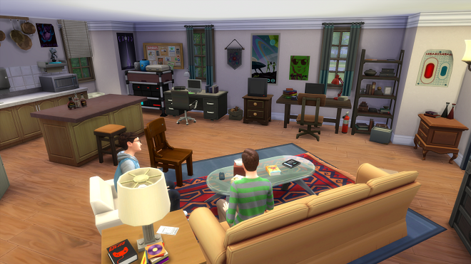
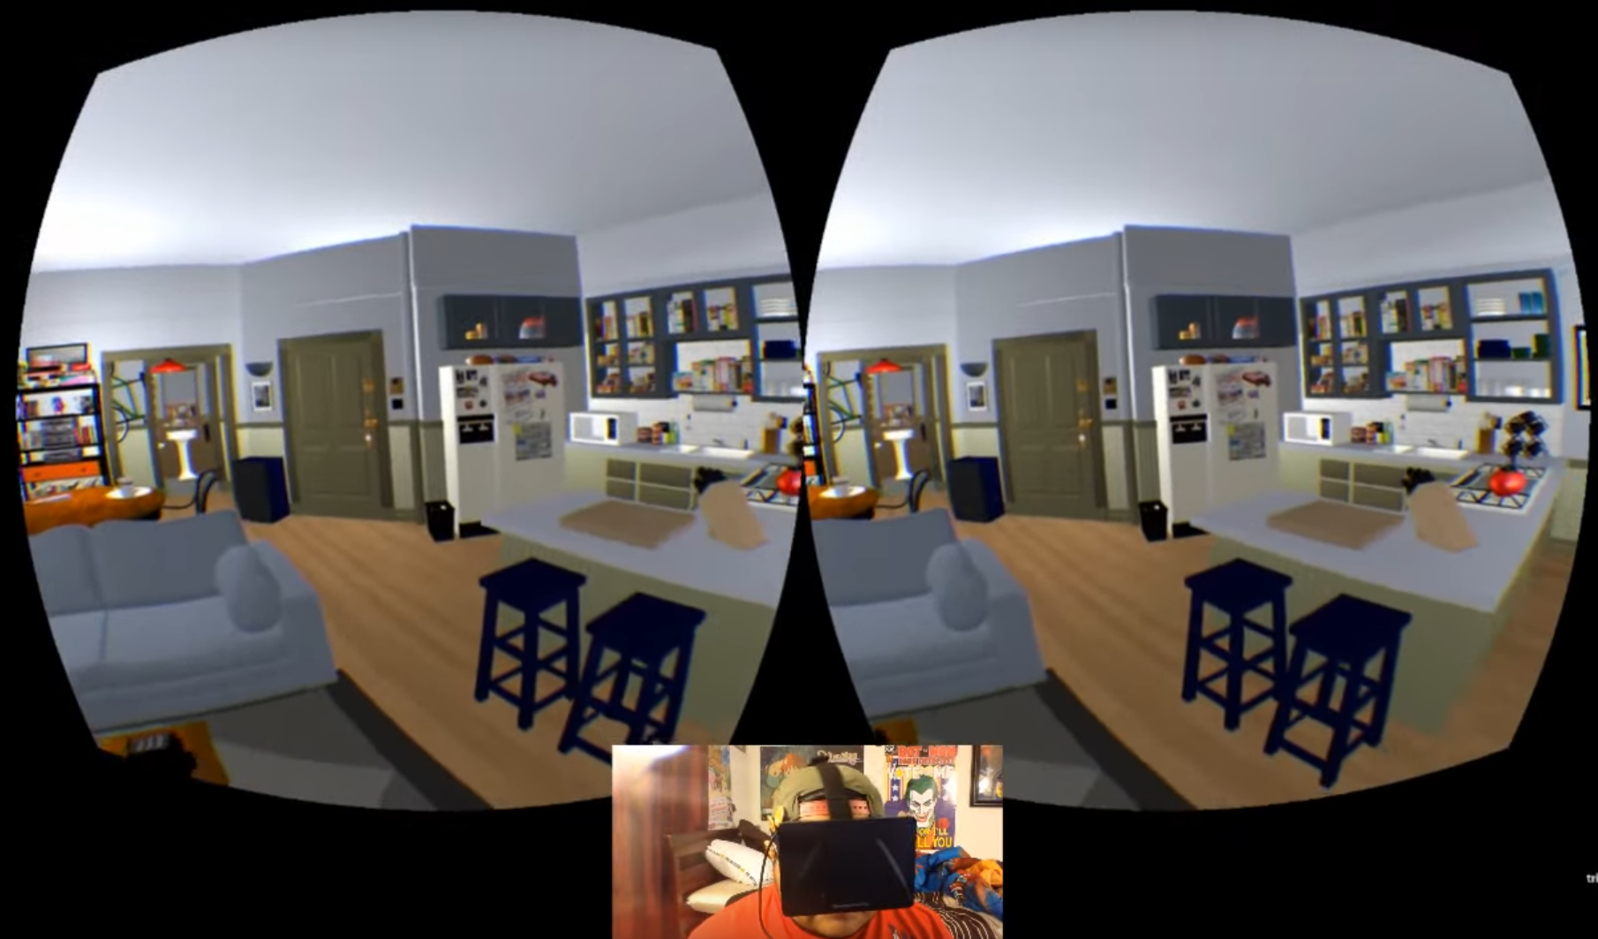
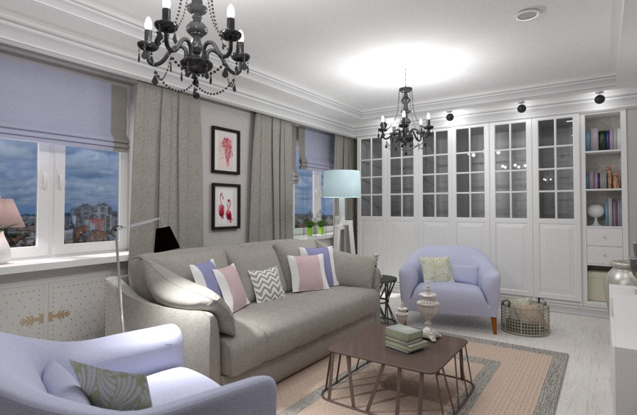

3D indoor scenes
3D Games
Virtual Reality
Interior Design
Augmented Reality
Notes:
In graphics, there is a popular demand for 3D indoor scenes.
For example, (CLICK) 3D scenes provide the virtual environments for 3D Games and VR.
They could also be used for (CLICK) interior design or AR applications.

Slide 3
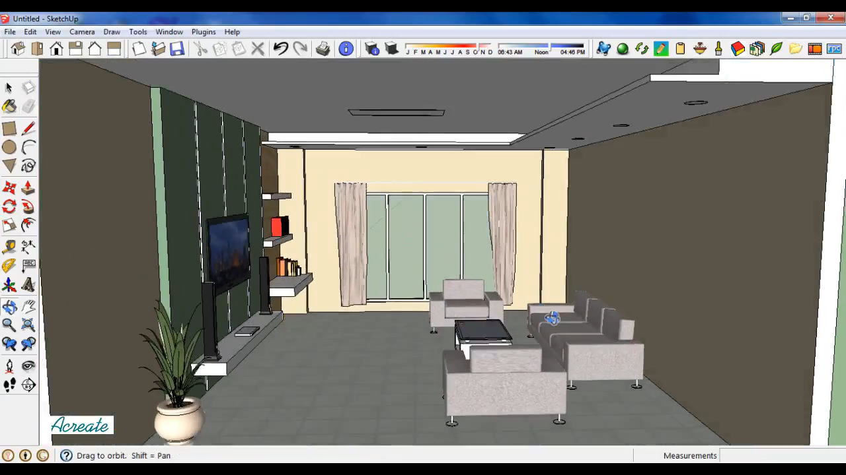
3D scene modeling
3D modeling software, e.g., Sketchup
Insert-and-adjust individual objects
Proficient modeling skills needed
Tedious process for complex scenes
Difficult for novice users
Notes:
3D scenes are usually created (CLICK) using the 3D modeling software, such as Sketchup.
A normal modeling process involves a user (CLICK) inserts individual objects and then adjusts their locations in the scene
There are significant challenges for creating scenes in this way (CLICK):
Proficient modeling skills are often needed;
Designing a 3D scene is often time-consuming and tedious, especially when creating complex scenes.
The modeling process is even more difficult for novice users.

Slide 4
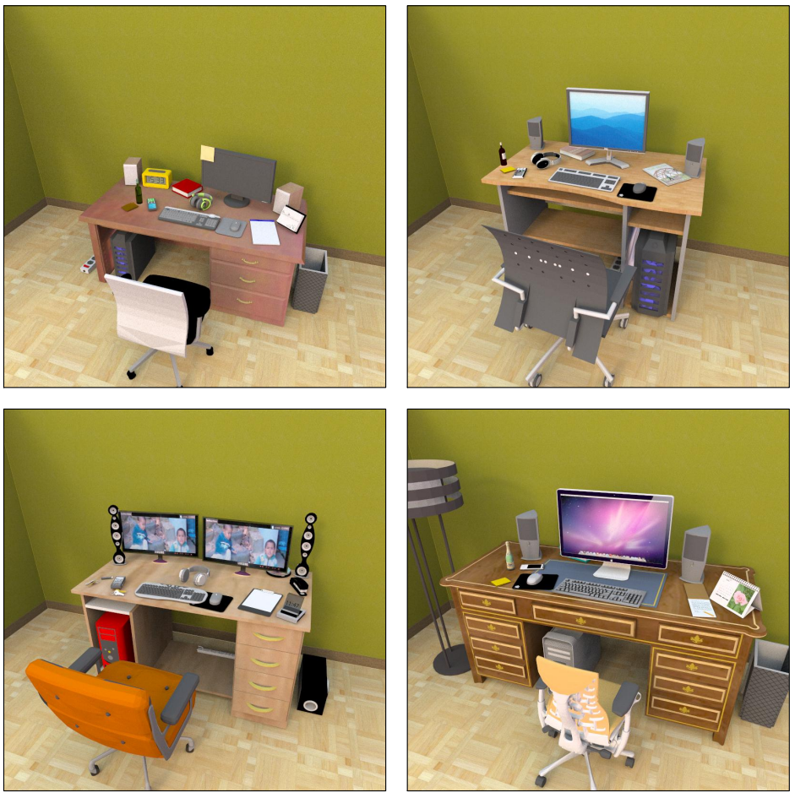
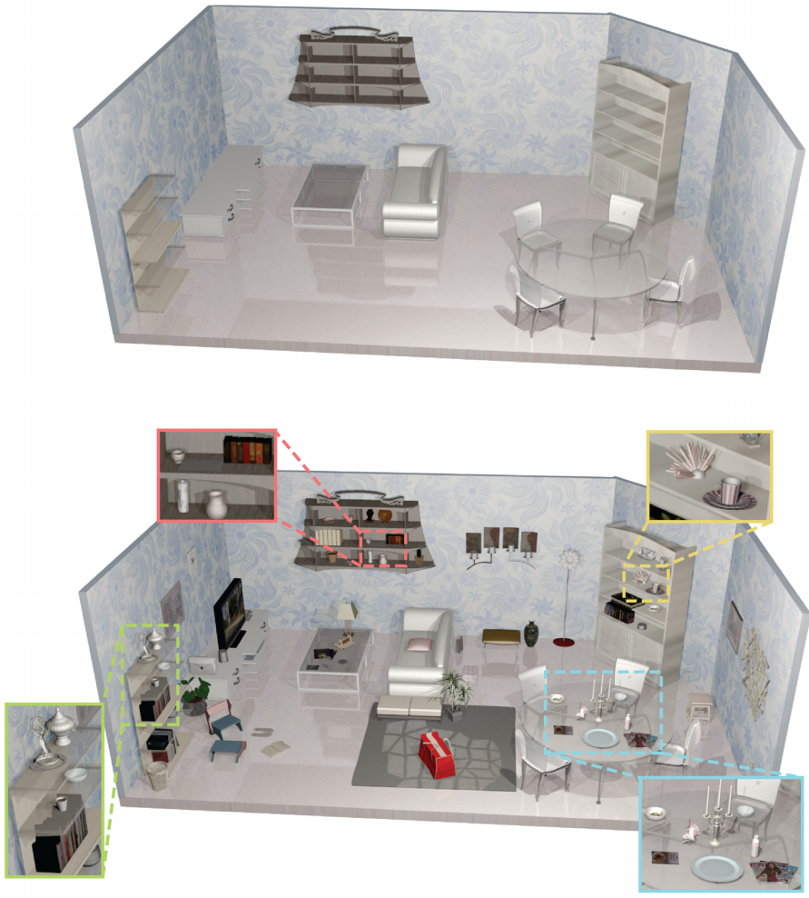
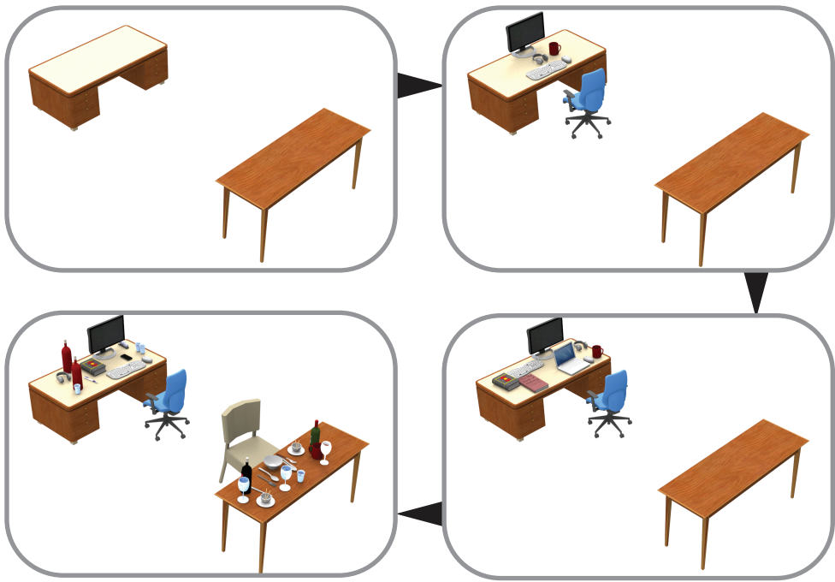
Data-driven scene modeling
Example-based scene synthesis
Suggestive scene modeling
Progressive scene evolution
[Fisher et al. 2012]
[Yu et al. 2016]
[Ma et al. 2016]
Notes:
For generation of complex and realistic scenes, data-driven scene modeling has been widely studied in recent years.
(CLICK) Fisher et al. introduced example-based scene synthesis to generate realistic scene arrangements based on object relations extracted from a scene database and a few examples.
(CLICK) Using the support relations learned from the scene database, Yu et al. propose a suggestive scene modeling tool to create detailed 3D scenes.
(CLICK) Recently, we propose the progressive scene evolution driven by human actions learned from annotated images.

Slide 5
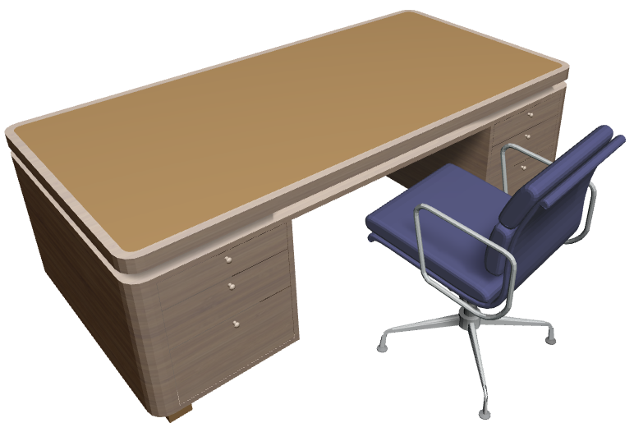
Text2Scene
Text or natural language
Most accessible input for content creation
There is a desk and a chair
Notes:
On the other hand, for novice users, (CLICK) text or natural language is the probably the most accessible input for content creation. For text-to-scene generation, (CLICK)

Slide 6
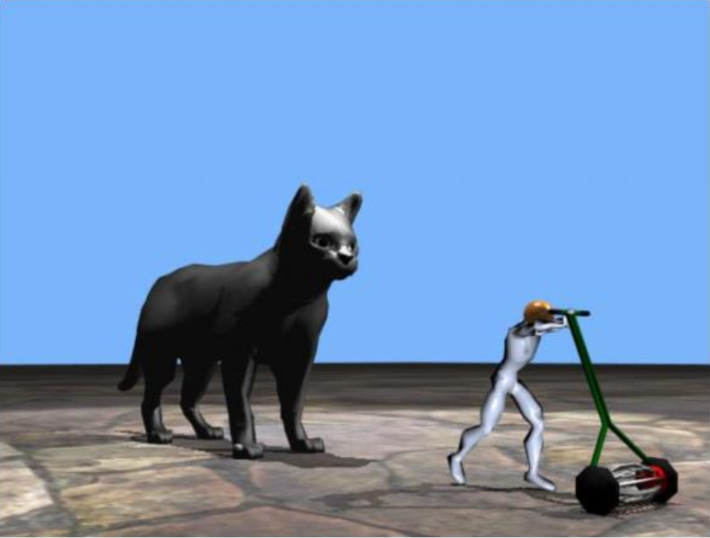
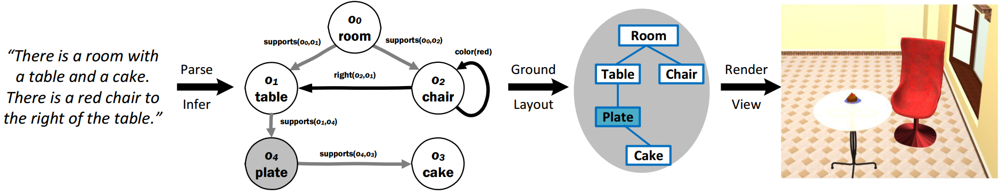
Text2Scene
“The lawn mower is 5 feet tall. John pushes the lawn mower. The cat is 5 feet behind John. The cat is 10 feet tall”
WordsEye: explicit scene arrangement languages
[Coyne et al. 2001]
Object-level 3D model placement
Simple text-to-scene mapping, i.e., only pairwise object relationships
Incompact language
Difficult to generate complex scenes
Text2scene based on spatial knowledge from scene databases
[Chang et al. 2014]
Notes:
The seminal work WordsEye from Coyne et al converts explicit scene arrangement languages into 3D scenes.
(CLICK) Chang et al perform text-to-scene based on spatial knowledge learned from scene databases.
The main limitation of these works is (CLICK) they mainly focus on placing individual objects and their text-to-scene mapping is only about pairwise object relations.
Also, (CLICK) their scene modeling language is incompact. It is difficult to generate complex scenes for these methods.

Slide 7
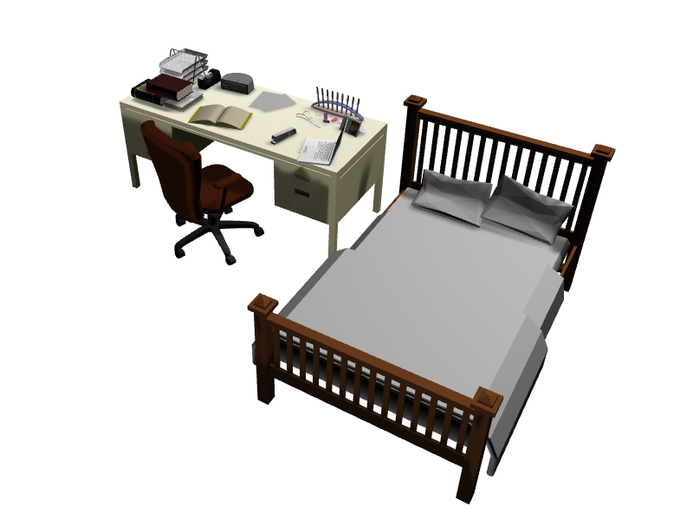
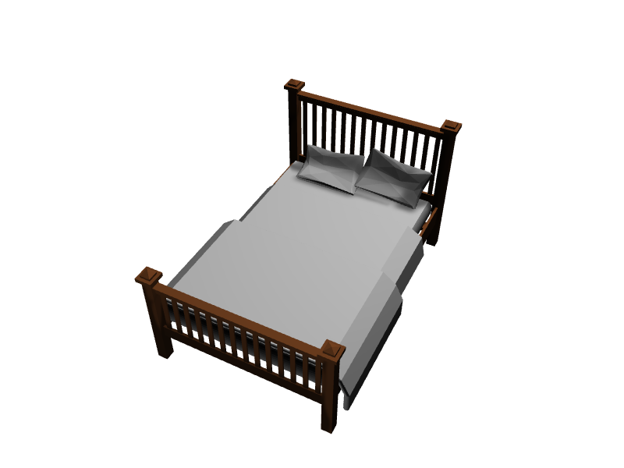
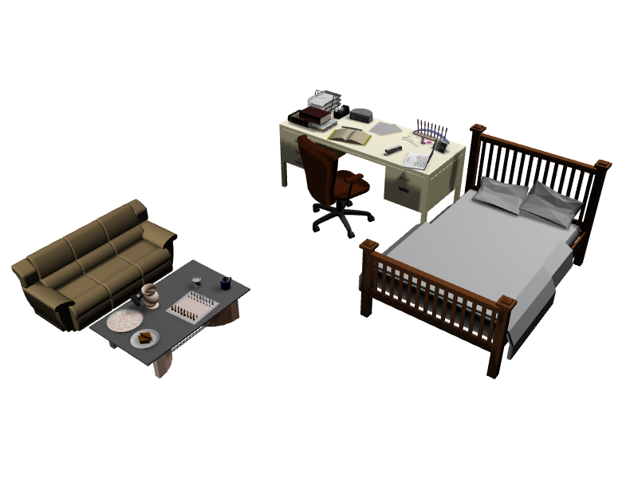
Goal
Use compact natural language for scene generation
Progressively improve the complexity of generated 3D scenes
There is a bed
A messy desk is next to the bed.
More sentences
Notes:
In this work, our goal is to (CLICK) use compact natural language for scene generation.
We aim to (CLICK) progressively improve the complexity of generated scenes and produce complex and realistic scenes at the end.

Slide 8
Challenges
Text to 3D scene mapping
Different data forms
Complex scenes from only a few sentences
Manipulate multiple objects at the same time using text
Progressive synthesis for Text2Scene
Use text commands to augment existing scenes
Notes:
To achieve our goal, there are some challenges.
First, (CLICK) since text and 3D scenes are in different data forms, a uniform representation is needed to establish the text-to-scene mapping.
Second, to achieve the efficiency, we aim to (CLICK) generate complex scenes from only a few sentences. This require us to manipulate multiple objects at the same time using text commands.
At last, to generate really complex scenes, progressive synthesis is needed. So, we must (CLICK) extend the progressive synthesis framework to text2scene and use text commands to augment existing scenes.

Slide 9
Contribution
Semantic scene graph
Uniform representation for natural language and 3D scenes
Relational model
Pairwise and group-wise object relations
Learn from scene databases
Complex text-to-scene mapping
Progressive Text2Scene
Sub-scene level synthesis
Beyond object-level processing
Notes:
To overcome these challenges, we make following contributions
First, we introduce the (CLICK) semantic scene graph as a uniform representation for natural language and 3D scenes.
Then we propose the (CLICK) relational model to characterize pairwise and group object relations and learn them from scene databases for complex text-to-scene mapping
At last, we develop a (CLICK) progressive text2scene framework which operates on the sub-scene level instead of the object-level processing as in previous work.

Slide 10
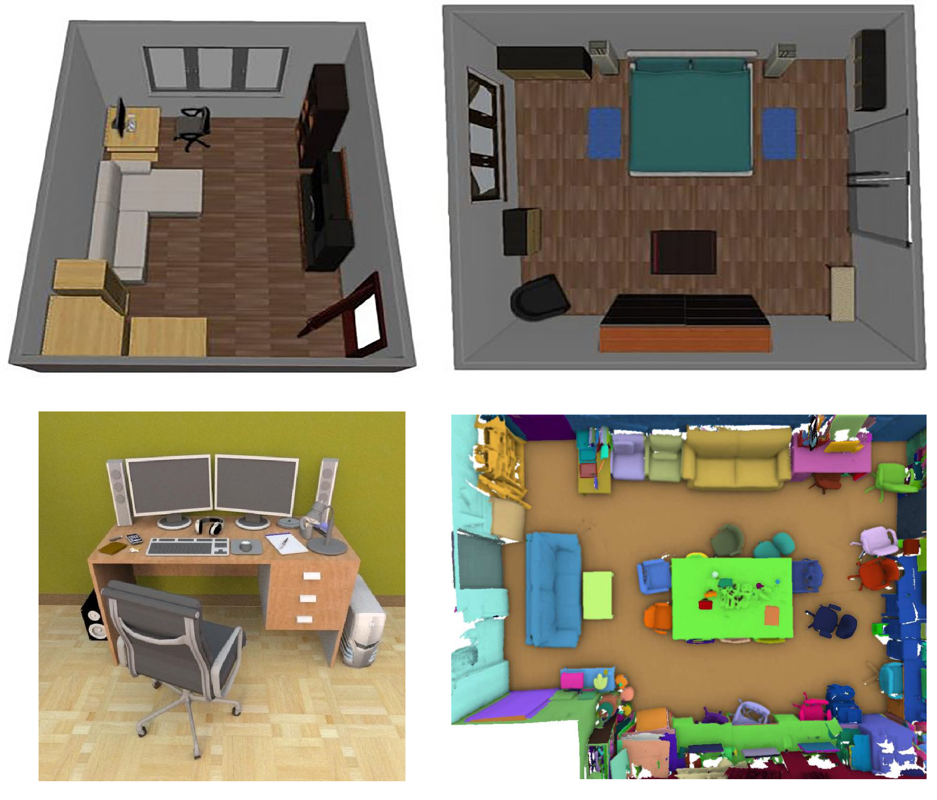
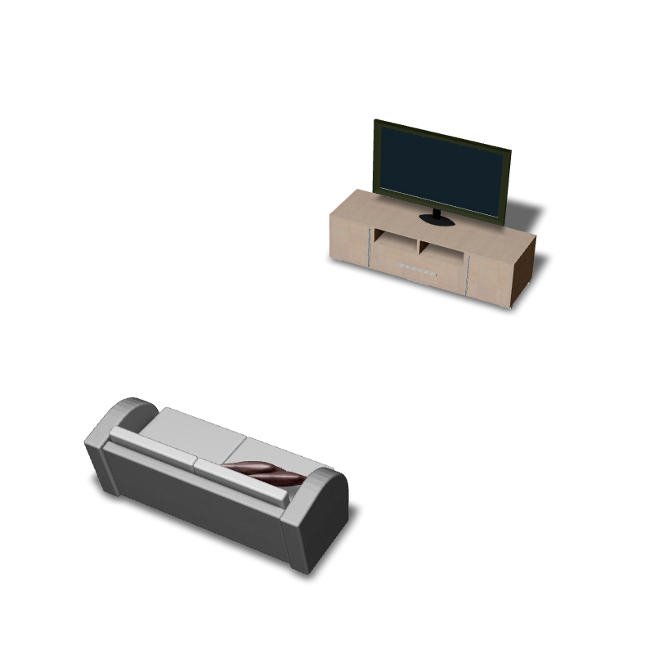
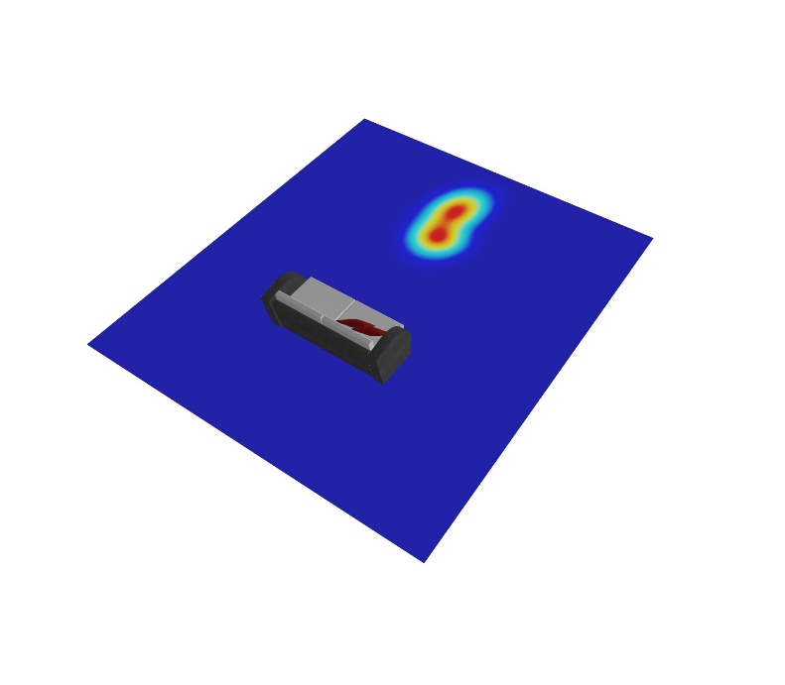

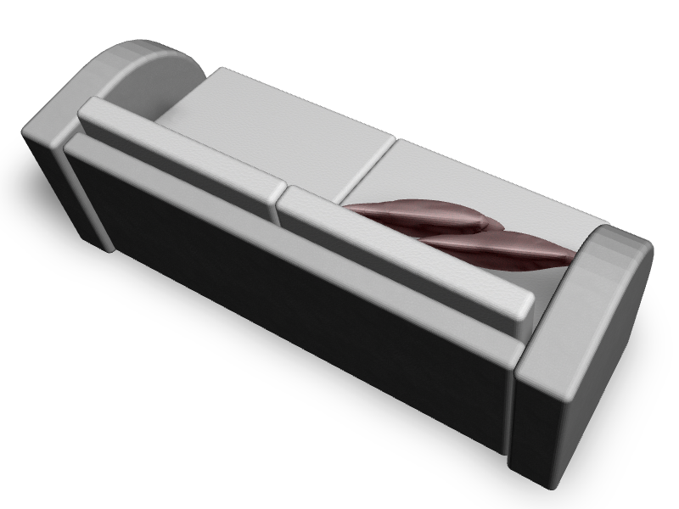
Overview
Semantic scene graph
Learning
There is a TV in front of the sofa.
+
Relational models
Sub-scenes
Synthesis
Notes:
Here is an overview of our system,
(CLICK) in the learning stage,
(CLICK) from the scene database, (CLICK) we build semantic scene graph for each 3D scene and extract relational models based on the object arrangements in the database
(CLICK) In the synthesis stage,
(CLICK) given the scene editing sentences, we
(CLICK) apply sub-scene retrieval and accommodation to enrich the existing scenes.

Slide 11
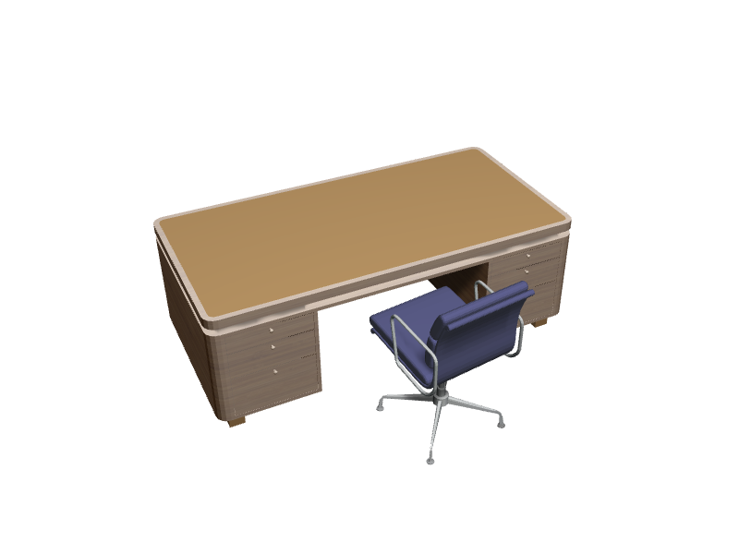
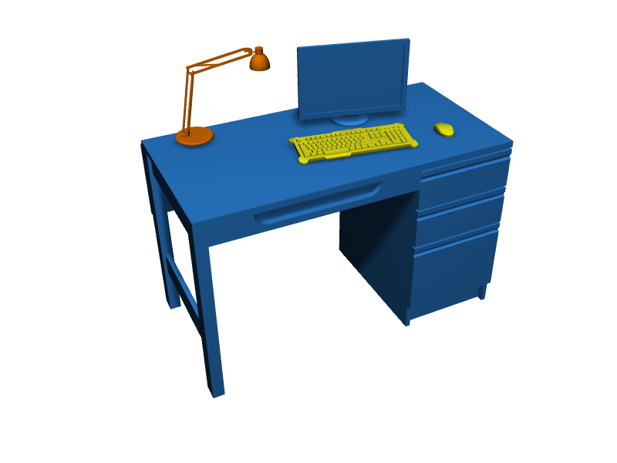

Language-driven scene synthesis
Sub-scene retrieval and accommodation
Scene databases
Current scene
There is a monitor on the desk and a lamp to the left of the monitor.
New scene
Retrieval
Accommodation
Notes:
At the core of our system is the language-driven scene synthesis enabled by
(CLICK) the sub-scene retrieval and accommodation framework.
(CLICK) Given a scene editing sentence, we use its semantic graph to retrieve related sub-scenes from scene databases and then accommodate the sub-scene into the current scene based on the text-to-scene mapping
(CLICK) We can progressively improve the complexity of the scenes by repeating this process.

Slide 12
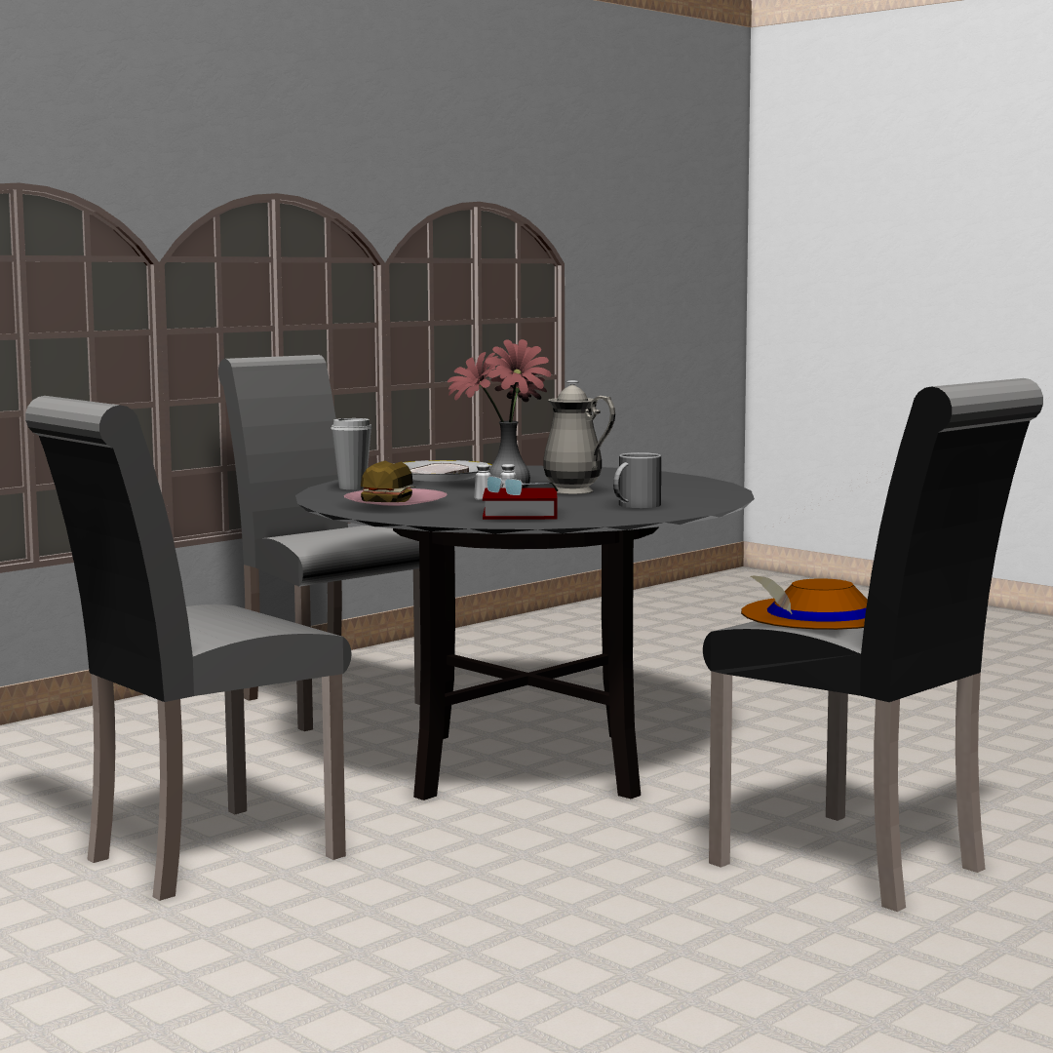
Uniform scene representation
“The round dining table is surrounded by three chairs and there is a ﬂower vase on top of the table.”
Vase
(flower)
On
Chair A
Chair B
Table
(round, dining)
Surrounded by
Chair C
Object node
Relationship node
Semantic Scene Graph (SSG)
Notes:
To enable text-to-3D-scene mapping, we need a uniform scene representation.
(CLICK) Given a scene modeling sentence and a 3D scene,
(CLICK) we extract objects and their relations and use the Semantic Scene Graph to bridge these two data forms.

Slide 13
Semantic scene graph
Nodes: objects and their geometric and semantic relations
Vase
(flower)
On
Chair A
Chair B
Table
(round, dining)
Surrounded by
Chair C
Object node
Relationship node
Notes:
For the semantic scene graph,
(CLICK) we have two types of nodes:
(CLICK) one is object node for each instance in the scene and the other is (CLICK) relationship node
which encodes geometric and semantic relations between objects.
An object node can also contain attributes, e.g., the Table node contains round and dining attributes here.

Slide 14
Semantic scene graph
Nodes: objects and their geometric and semantic relations
Edges: connect object and relation nodes
Vase
(flower)
On
Chair A
Chair B
Table
(round, dining)
Surrounded by
Chair C
Object node
Relationship node
Notes:
The graph edges simply connect object and relationship nodes.
By encoding rich semantic information between objects and their relations, the semantic scenes graph can serve as a uniform representation for 3D scenes and text.
Next, I will show how to construct semantic graph from text and 3D scenes.

Slide 15
Semantic graph from text
Natural language processing
Sentence parsing
Pattern matching
The round dining table is surrounded by three chairs and there is a ﬂower vase on top of the table.
Notes:
To build the semantic graph from text, we propose a (CLICK) natural language processing module which applies sentence parsing and pattern matching to extract objects and their relations in the sentences.
(CLICK) Given this sentence, the NLP module can automatically extract
(CLICK) objects, relations, and a set of attributes and modifiers.
The parsing result can be easily converted into a semantic graph.
For more details, please refer to our paper.

Slide 16
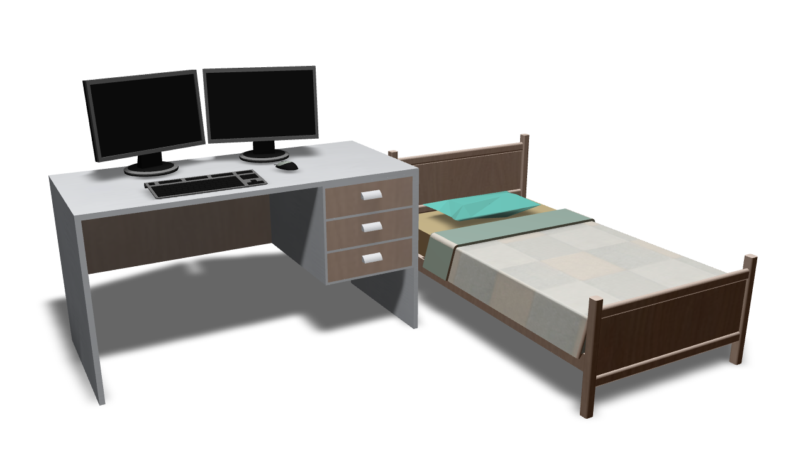
Semantic graph from a 3D scene
Notes:
To build the semantic graph from (CLICK) a 3D scene

Slide 17
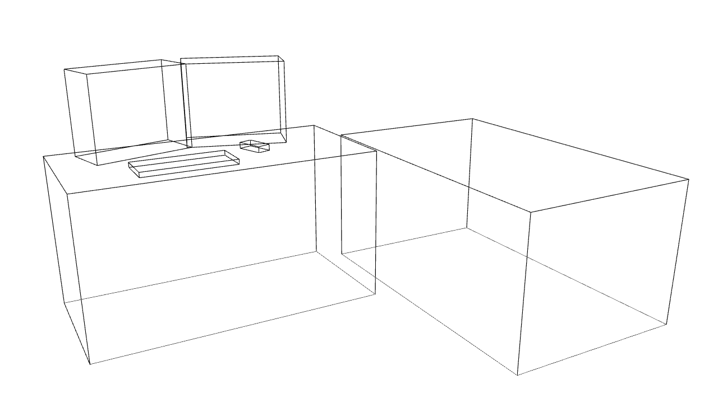
Semantic graph from a 3D scene
Up
Right
Front
Relation extraction: estimating spatial arrangements in object-centric frame
Notes:
we first abstract objects into bounding boxes.
Then we (CLICK) extract the relations by estimating spatial arrangements of bounding boxes in the object-centric frame.
For example, we create a (CLICK) coordinate frame at the center of the desk to extract its relations to other objects.

Slide 18
Semantic graph from a 3D scene
Monitor
Monitor
Keyboard
Mouse
On
On
On
On
Desk
Right Side
Bed
Notes:
By estimating the relations between every pair of objects, we can
(CLICK) construct the semantic graph.

Slide 19
Text to complex scenes
Learn rich semantics from existing scene databases
Context: object co-occurrence, relative locations
Complex relationships
Map text to complex scene arrangements by learning from scene database?
Notes:
To generate complex scenes from text,
a natural idea is to use the data-driven method and (CLICK) learn the rich semantics from existing large scene databases,
for example, (CLICK) the context information about object co-occurrence and relative locations, and the
(CLICK) complex relationships of object arrangements.
Now, the problem is (CLICK) how to map text to complex scene arrangements by learning from scene databases?

Slide 20
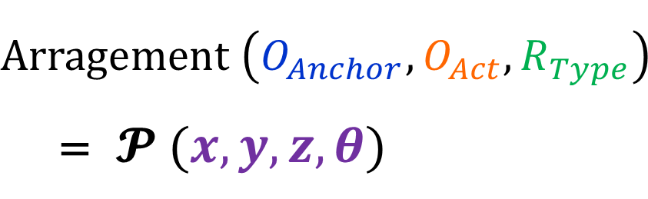
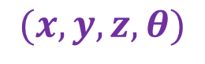
Relational model
Pairwise relation
on, left side, right side, front, back etc.
Up
$$Arragement \left(O_{Anchor}, O_{Act},R_{Type}\right)$$ = $𝓟 (x, y, z,θ)$
Right
$$(x, y, z,θ)$$
Front
Anchor object
Active object
Notes:
We propose the relational model to solve this problem. (CLICK) First, for pairwise relation such as “on”, “leftside”, “right side”
(CLICK) in the object-centric frame,
(CLICK) we define the center object as the Anchor object and other objects as Active objects, and compute the
(CLICK) relative position and orientation between them.
(CLICK) Then we define a probabilistic arrangement model to capture the spatial distribution of the act object to the anchor object for certain relation type.

Slide 21
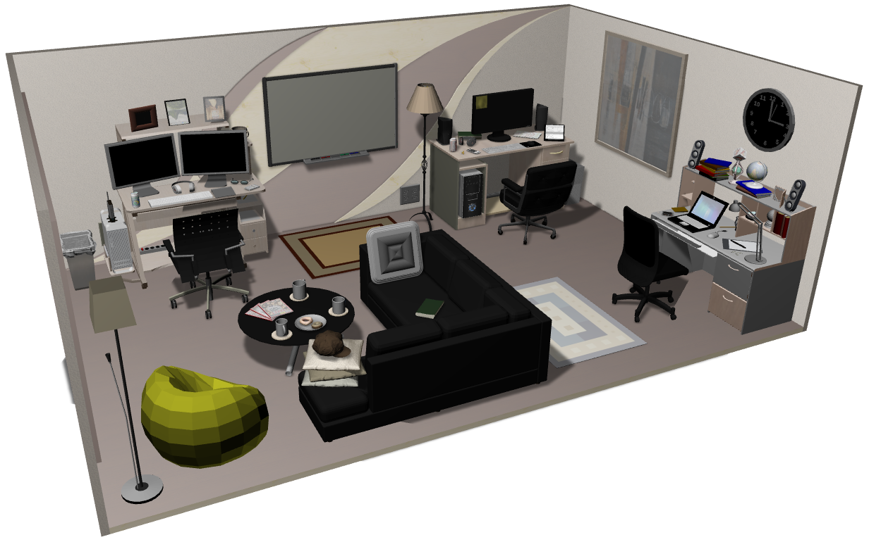
Relational model
Group relation
messy, organized, around etc.
Notes:
We also model group relation which corresponds to complex object arrangements (CLICK) such as messy, organized and around
To learn the group relational model,
we manually annotate (CLICK) 3D scenes with high-level group relations. (CLICK)

Slide 22
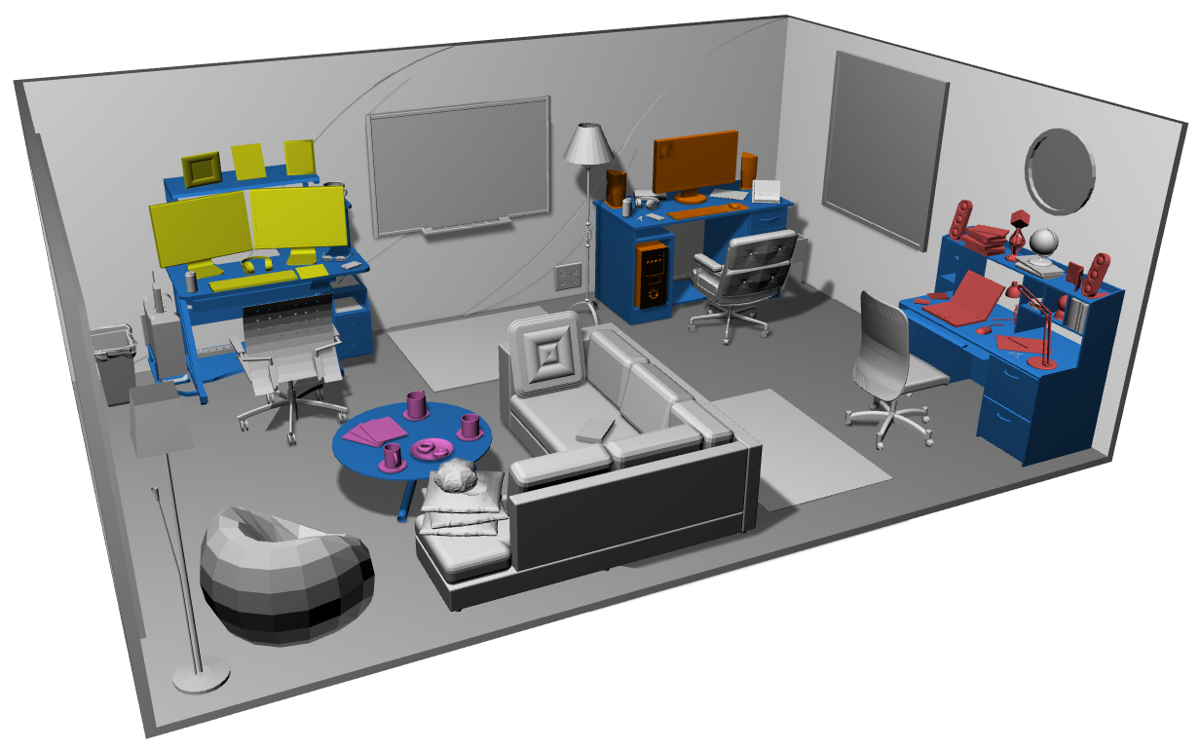
Relational model
Group relation
messy, organized, around etc.
Organized
Anchor object
Active objects
Messy
Casual
Notes:
For each instance of group relation, we define (CLICK) an anchor object and a set of active objects.
Then we learn the object distributions for each group relation from the annotated scene databases.

Slide 23
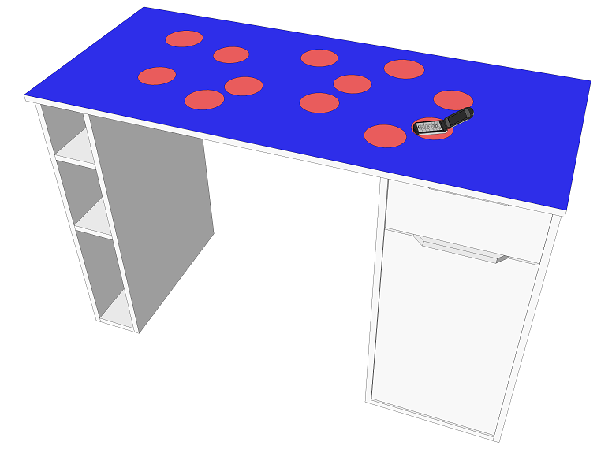
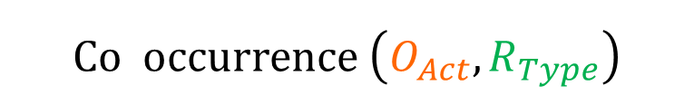
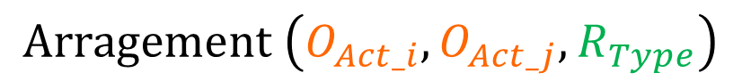
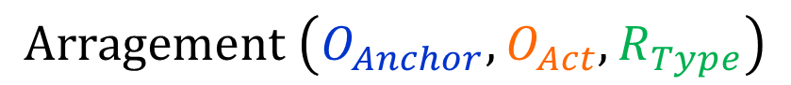
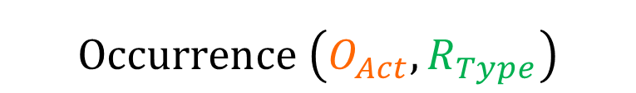
Relational model
Group relation
Example: Rel(desk, messy)
$$Occurrence \left(O_{Act},R_{Type}\right)$$
$$Arragement \left(O_{Anchor}, O_{Act},R_{Type}\right)$$
$$Co occurrence \left(O_{Act},R_{Type}\right)$$
-
$$Arragement \left(O_{Act_i}, O_{Act_j},R_{Type}\right)$$
Notes:
For example, for group relation model (desk, messy), we calculate (CLICK) the occurrence and co-occurrence of the active objects in the group relation.
Similar to pairwise relations, we model the (CLICK) arrangement between anchor and active objects, and also the arrangement between the active objects themselves.

Slide 24
Overview
Semantic scene graph
Learning
There is a TV in front of the sofa.
+
Relational models
Sub-scenes
Synthesis
Notes:
By now, we have learned how to construct semantic scene graphs from 3D scenes and text, and how to compute relational models from databases.
Now let’s look at how our (CLICK) language-driven scene synthesis work.

Slide 25
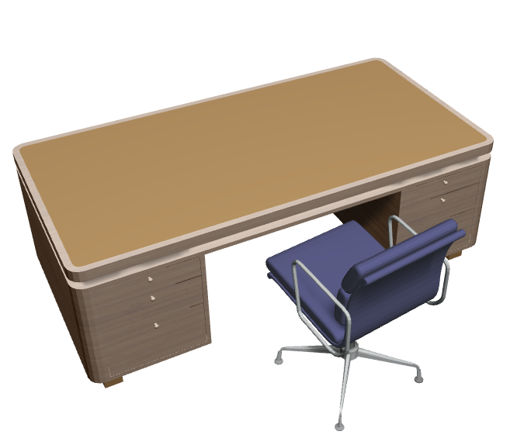
Language-driven scene synthesis
Initial scene
Scene modeling sentence
There is a monitor on the desk and a lamp to the left of the monitor.
Notes:
The goal of language-driven scene synthesis is to use (CLICK) scene modeling sentences to generate new scenes, perhaps from an initial scene (CLICK).
Here, we want to generate a scene with “a monitor on the desk and a lamp to the left of the monitor.”

Slide 26

Sub-scene retrieval
There is a monitor on the desk and a lamp to the left of the monitor.
Lamp
left of
Monitor
Monitor
Mouse
Monitor
Monitor
Keyboard
on
on
on
on
on
on
Desk
Desk
Desk
Desk
Speakers
on
on
Laptop
Notes:
The first step is sub-scene retrieval.
(CLICK) We convert the sentence into semantic graph and use the graph to
(CLICK) retrieve scenes with common sub-graphs from the database.
Here the matched sub-scene is shown in blue (CLICK).

Slide 27


Sub-scene augmentation
Synthesize from text using relational model
There is a monitor on the desk and a lamp to the left of the monitor.
Relational model
Lamp
Lamp
left of
left of
Lamp
left of
Monitor
Monitor
Monitor
on
on
on
Desk
Desk
Desk
Notes:
Our next step is to augment the retrieved sub-scene based on the text.
Since it is possible that not every object and relation specified in the text is matched, e.g.,
(CLICK), “a lamp to the left of the monitor” is not matched here.
For this case, we (CLICK) synthesize the arrangement of the lamp based on the relational model and update the graph of the scene

Slide 28

Sub-scene augmentation
Enrich with scene context
There is a monitor on the desk and a lamp to the left of the monitor.
Lamp
Lamp
left of
Left of
Lamp
left of
Monitor
Monitor
Mouse
Monitor
Keyboard
on
on
on
on
on
Desk
Desk
Desk
Notes:
To further increase the complexity of the result, we also allow
(CLICK) enriching the scene with scene context from the database.
For example, as mouse and keyboard have high co-occurrence frequency with the monitor in the database, we can augment the sub-scene with the (CLICK) mouse and keyboard

Slide 29

Sub-scene accommodation
Lamp
left of
Mouse
Monitor
Keyboard
on
on
on
Desk
Desk
Desk
Chair
Desk
near
Notes:
Now, with the augmented sub-scene, our goal is to splice its objects into
(CLICK) current scene. We call this step as sub-scene accommodation.
First, we find the matched anchor objects in both graphs. Here, the desk (CLICK) serves as an anchor.

Slide 30


Sub-scene accommodation
Lamp
left of
Lamp
left of
Mouse
Monitor
Keyboard
Mouse
Monitor
Keyboard
on
on
on
on
on
on
Desk
Desk
Desk
Chair
Desk
near
Notes:
Then the objects in the sub-scene are transformed to the current scene by using the alignment transformation computed from the anchor objects.
(CLICK) Finally, the graph of current scene is updated.

Slide 31

Apply group relation
Retrieve and accommodate active objects
Synthesize new active objects based on relational model
Rel(desk, messy)
Lamp
Left of
The desk is messy
Mouse
Monitor
Keyboard
on
on
on
Messy
Desk
Desk
Desk
Desk
near
Chair
Notes:
To apply the group relations in scene synthesis, we use two schemes:
(CLICK) The first is to retrieve and accommodate the active objects from the database scene.
(CLICK) The second option is to directly synthesize new active objects based on the learned group relational model
(CLICK) For example, continue with the scene from previous step.
(CLICK) Given a new sentence, we first (CLICK) align the desk in two graphs and then
(CLICK) apply the group relational model (desk, messy) to place active objects on the desk in current scene.

Slide 32
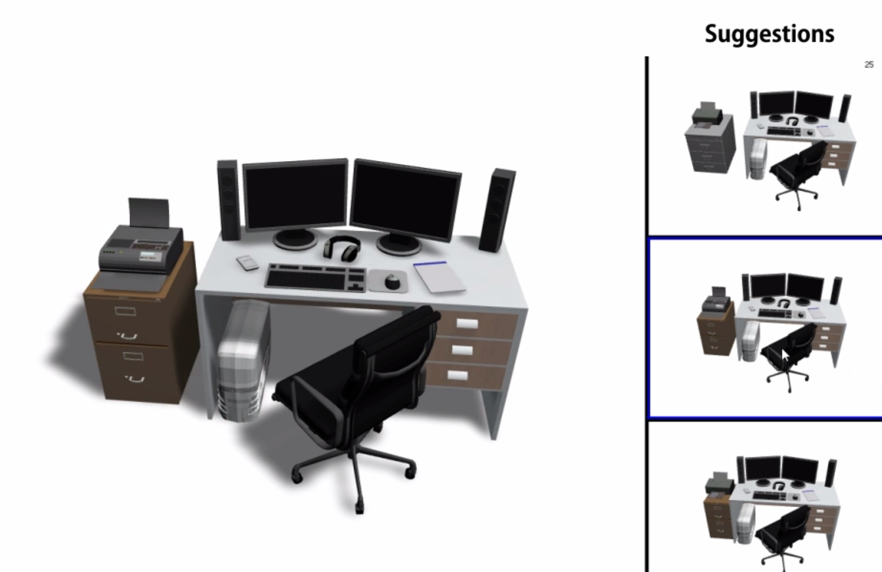
Suggestive interface
Consider ambiguity in natural language
Show several possible scene arrangements
Unknown object or relation types
Failure message
Notes:
To further improve the results, we design a suggestive interface to consider
(CLICK) the ambiguity in natural language.
We show several possible scene arrangements for the given sentence and let the user choose which one she likes most.
Also, if there is any (CLICK) unknow object or relation types for our system, our interface will return a (CLICK) failure message to inform the user which part cannot be satisfied.

Slide 33
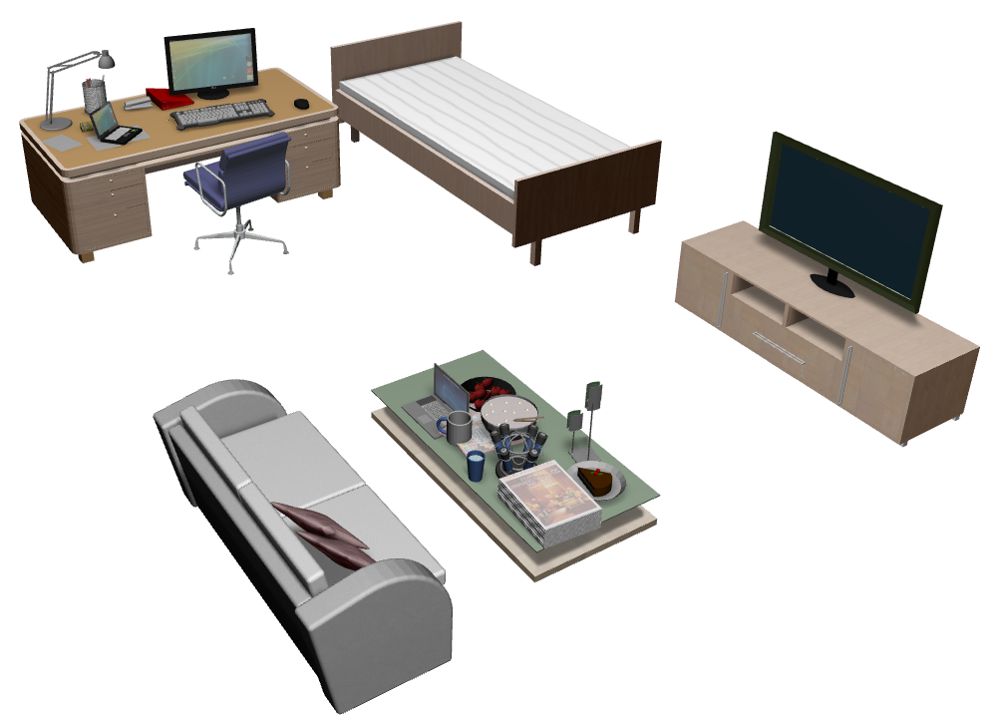
Progressive synthesis
+
+
The desk is messy
More sentences
Notes:
By repeating (CLICK) the process of sub-scene retrieval and accommodation, we can achieve progressive scene synthesis and generate complex scenes.

Slide 34

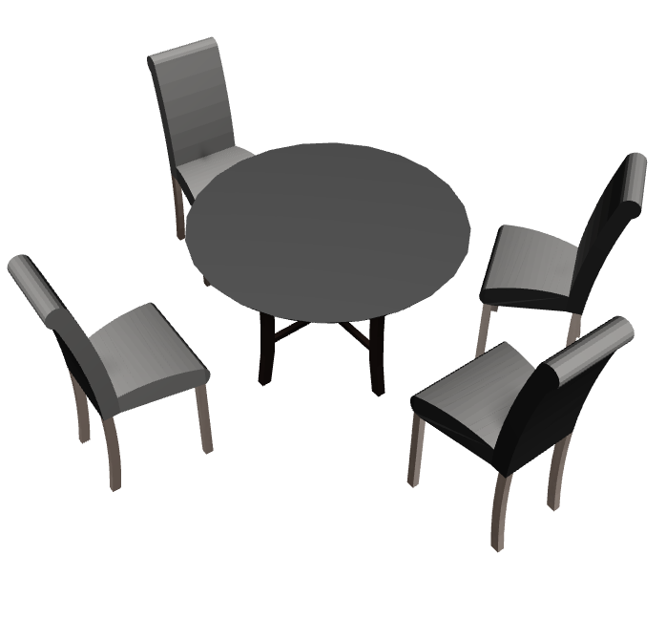
Results
There are four chairs around a round dining table.
Variation 1
Variation 2
Notes:
Now, let’s see some results.
(CLICK) Given the sentence,
(CLICK) we can generate scenes with complex spatial relations such as “around“.

Slide 35
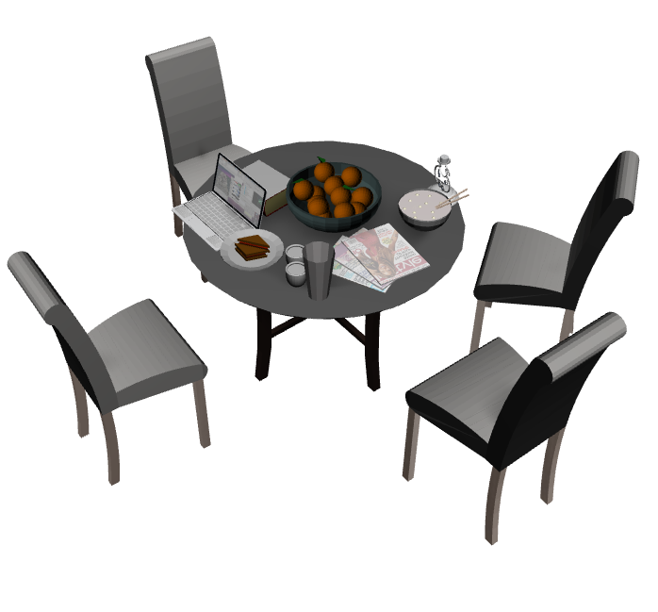

Results
The table is messy.
Variation 1
Variation 2
Notes:
we can also apply the group relational model to (CLICK) add multiple objects into the scene

Slide 36
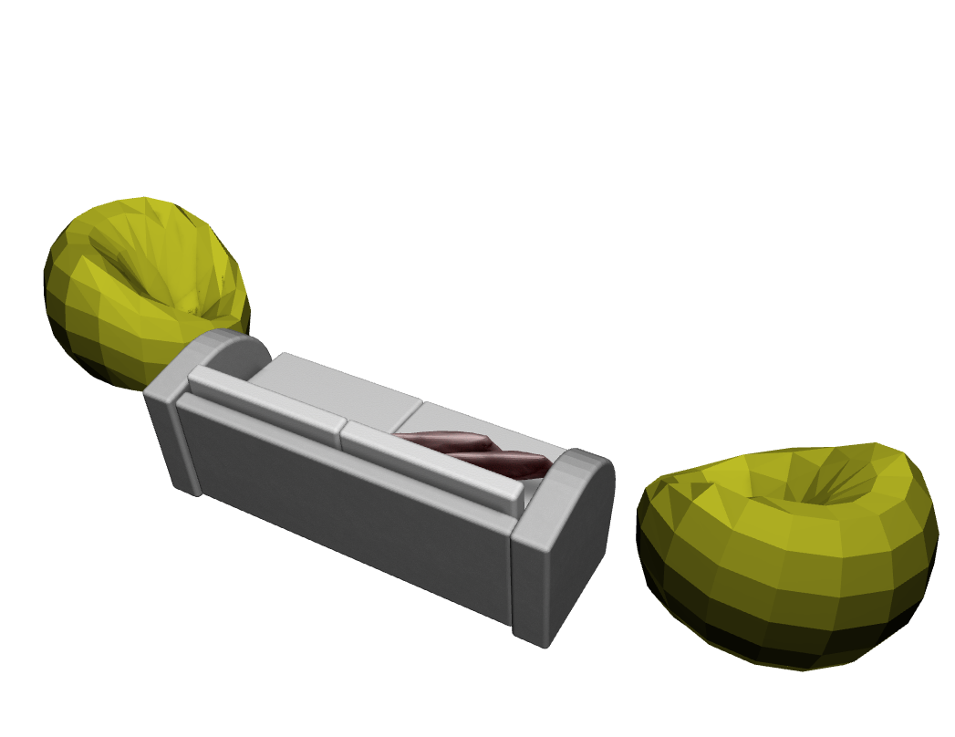
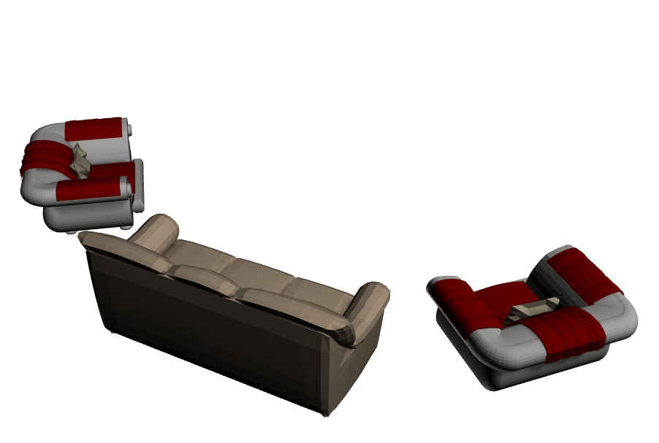
Results
There is a couch and two sofa chairs in the room.
Variation 1
Variation 2
Notes:
Here is another result. Although in this sentence, there is no relations specified between the couch and sofa chairs, they are placed plausibly because of the sub-scene retrieval scheme.

Slide 37
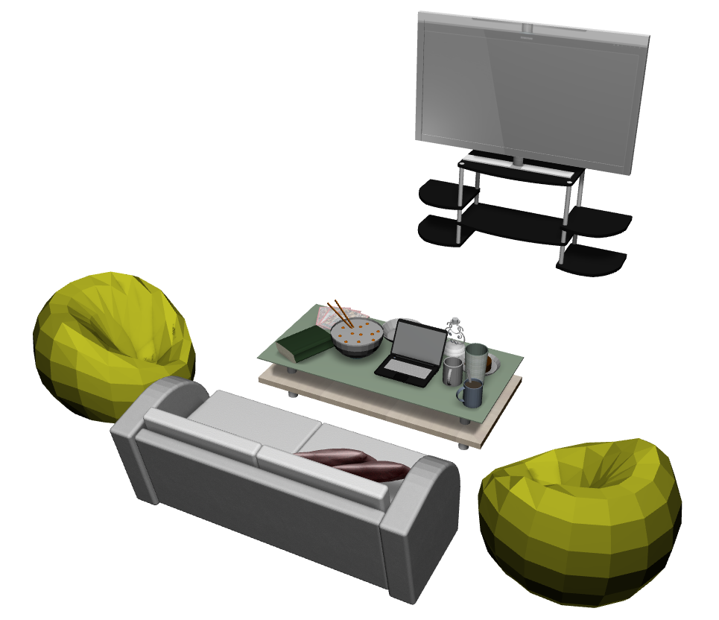
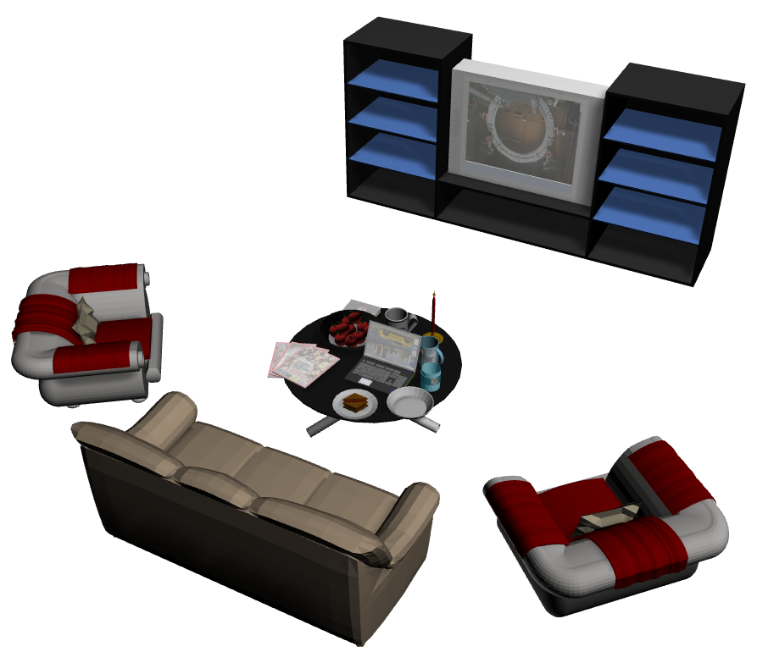
Results
In front of the couch is a messy coffee table and a TV
Variation 1
Variation 2
Notes:
For this sentence, even though only TV is mentioned,
our system can (CLICK) automatically generate a TV stand to support the TV.
This is because we can use the scene context from the database to bring in needed objects.

Slide 38
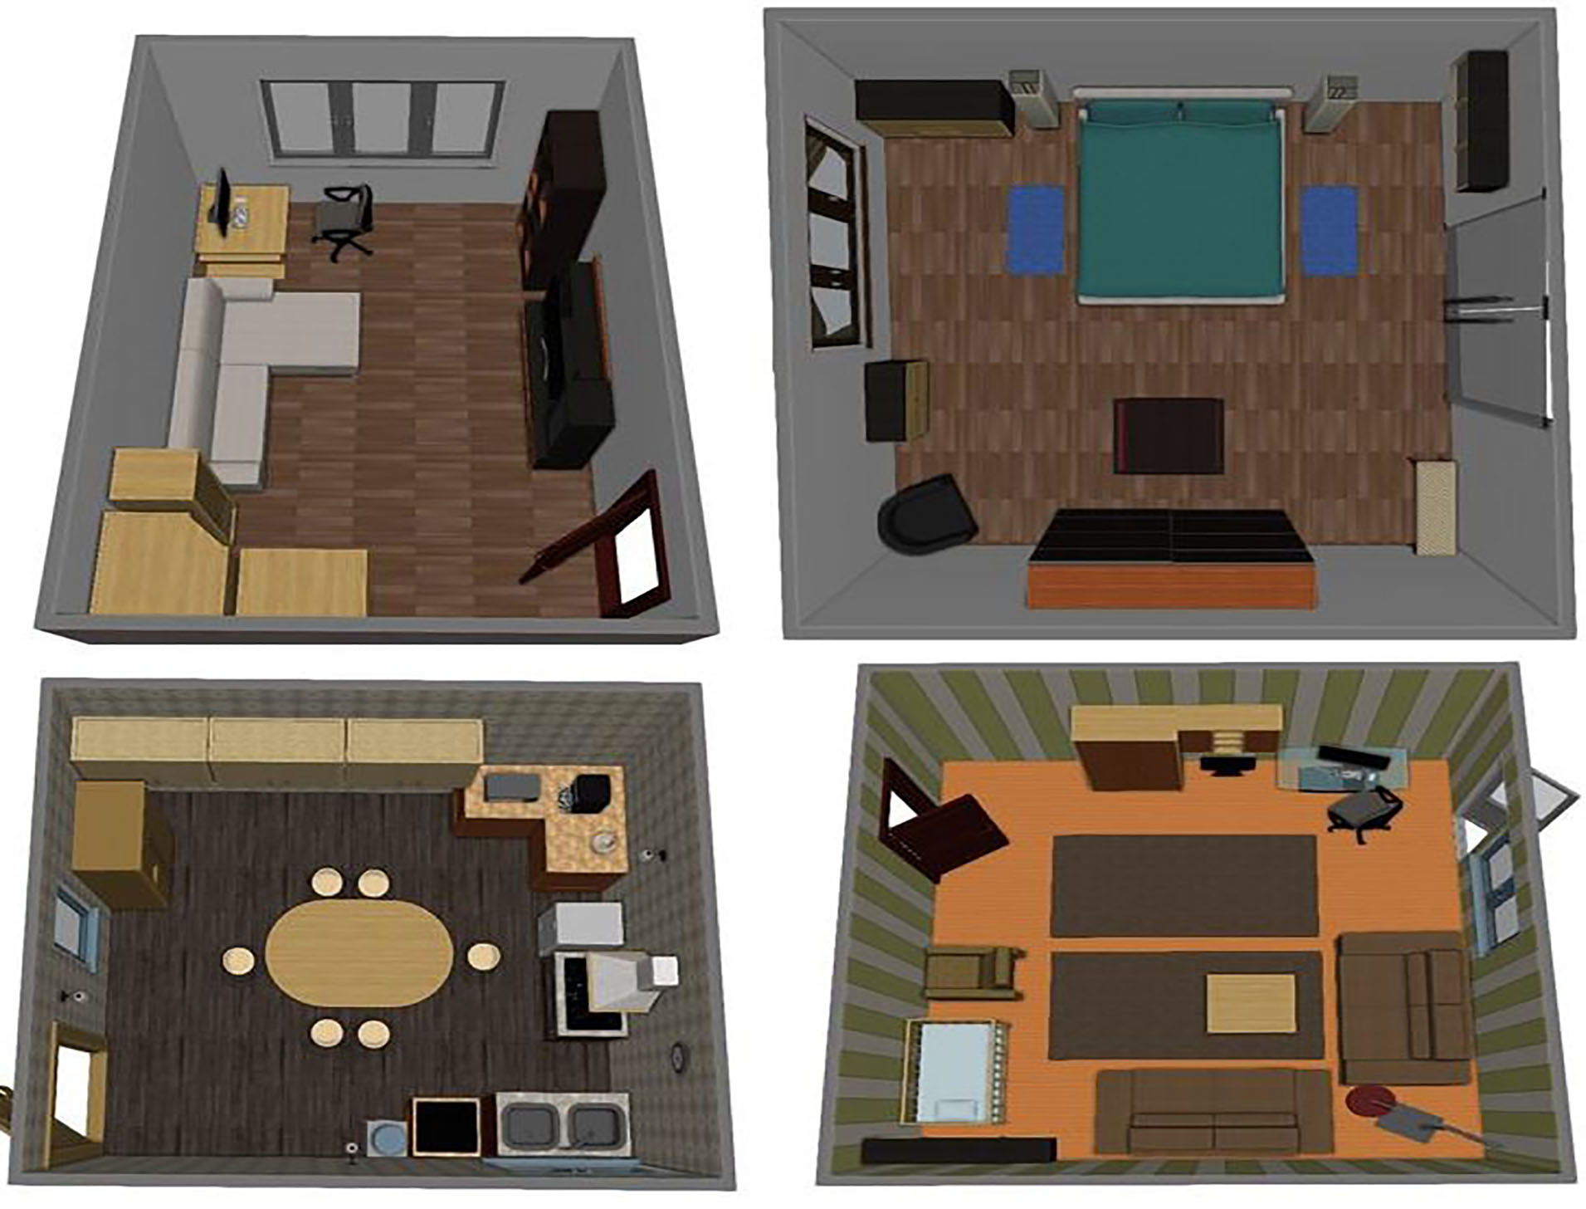
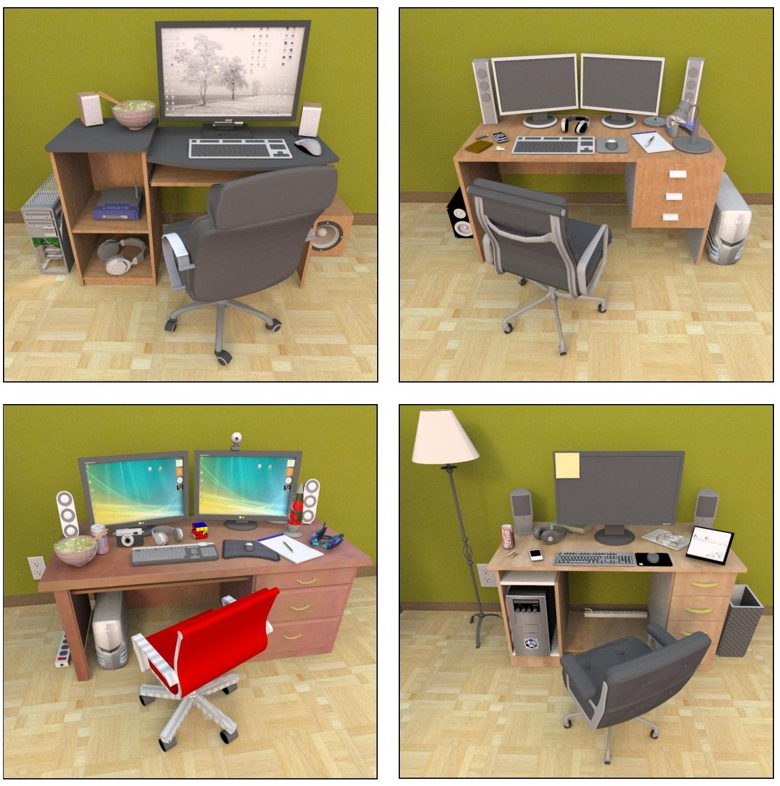
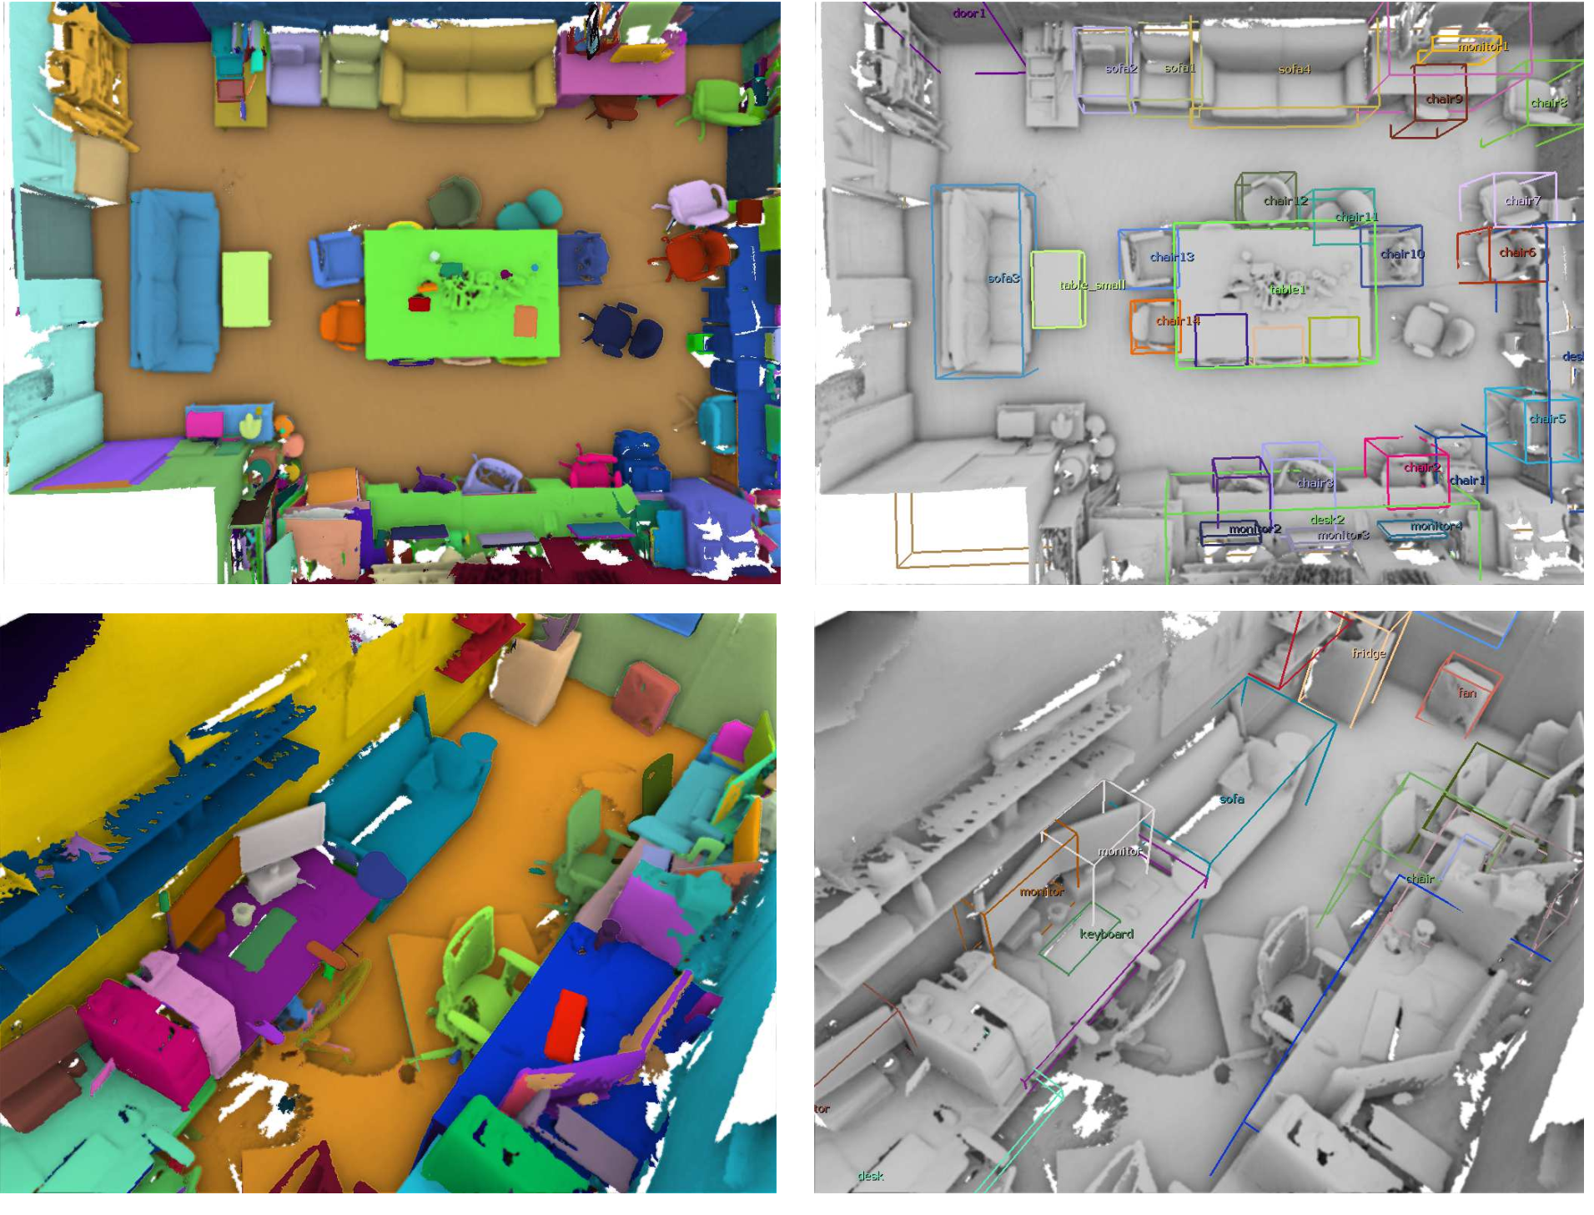
Results
Databases:
#Scenes | #Group relation type | #Annotation/group relation
3197 | 11 | 50~100
SunCG [Song et al. 2017]
SceneSynth [Fisher et al. 2012]
SceneNN [Hua et al. 2016]
Notes:
Here are some statistics.
(CLICK) Our databases contains more than 3000 scenes and we annotated them with 11 high-level group relations.
For each group relation, there are about 50 to 100 annotation instances.
(CLICK) The scenes are collected from various scene datasets so that we can learn scene context from different sources.

Slide 39
Results
Databases:
Language efficiency
Three sentences to 20~30 objects
Compact language → complex results
Timing:
1~5 seconds for sub-scene retrieval and accommodation
Most cost is on collision detection
#Scenes | #Group relation type | #Annotation/group relation
3197 | 11 | 50~100
Notes:
Our system achieves high language efficiency. For example we can use only three sentences to generate a scene with 20 to 30 objects, showing we can use
(CLICK) compact language to generate complex results.
(CLICK) For the timing, excluding the model loading time, it takes about 1 to 5 seconds for sub-scene retrieval and accommodation,
while the most cost is on the collision detection.

Slide 40
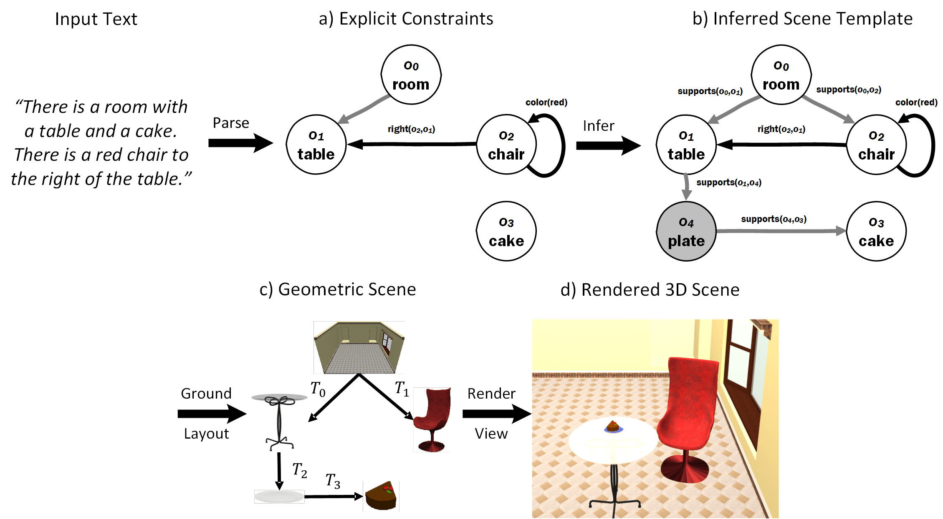
Evaluation: plausibility user study
10 scene editing scenarios： bedroom, dining room, living room, office
Text2Scene [Chang et al. 2014]
Notes:
To evaluate our method,
We perform the plausibility user study as previous works on scene synthesis.
(CLICK) We test our methods for 10 scene editing scenarios
And compare the scenes with the results generated by
(CLICK) the Text2Scene method of Chang et al.

Slide 41
Evaluation: plausibility user study
Rate from 1 to 5 (higher better)
Plausibility w.r.t given text description
Naturalness for overall scene arrangement
Notes:
We ask the user to (CLICK) rate 1 to 5 score by considering the
(CLICK) scene plausibility w.r.t the given text description
(CLICK) and the naturalness for the overall scene arrangement
(CLICK) From the results, our scenes receive higher voting scores, showing the effectiveness of our method.

Slide 42
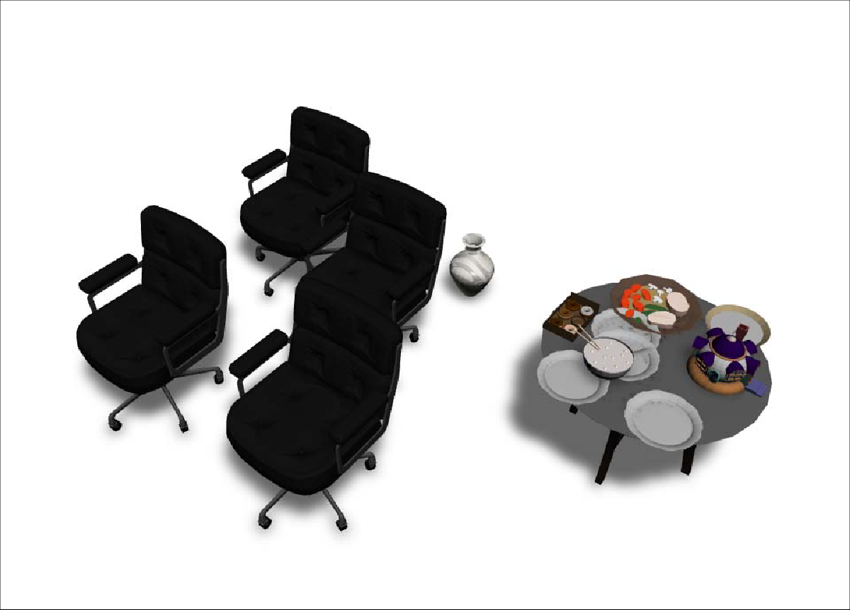
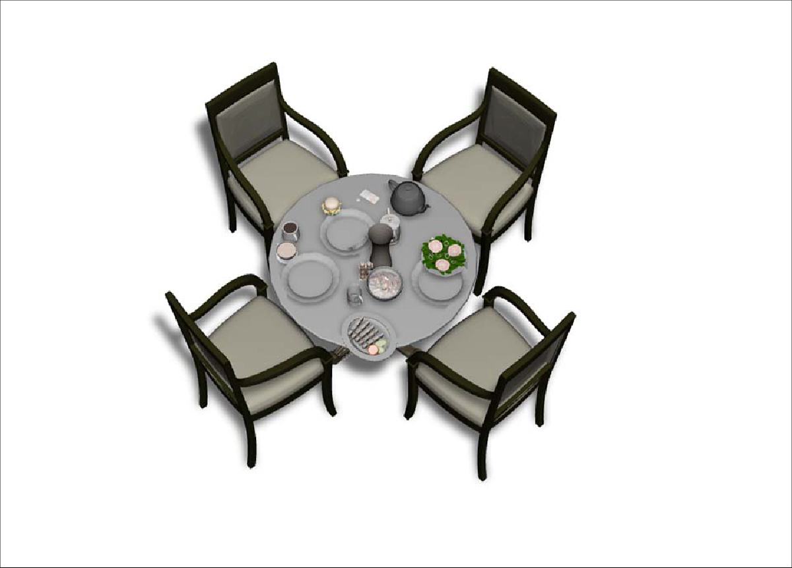
Evaluation: compare to [Chang 2014]
There are four chairs around a round dining table. On the table, there is a vase, a teapot, and dinner plates.
Our
[Chang et al. 2014]
No group relational model
Notes:
Here is an example when Chang’s method fails.(CLICK)
For Chang’s method, since they
(CLICK) do not learn the group relational model such as around, objects can only be inserted to the scene individually.
Therefore, implausible results may be produced.

Slide 43
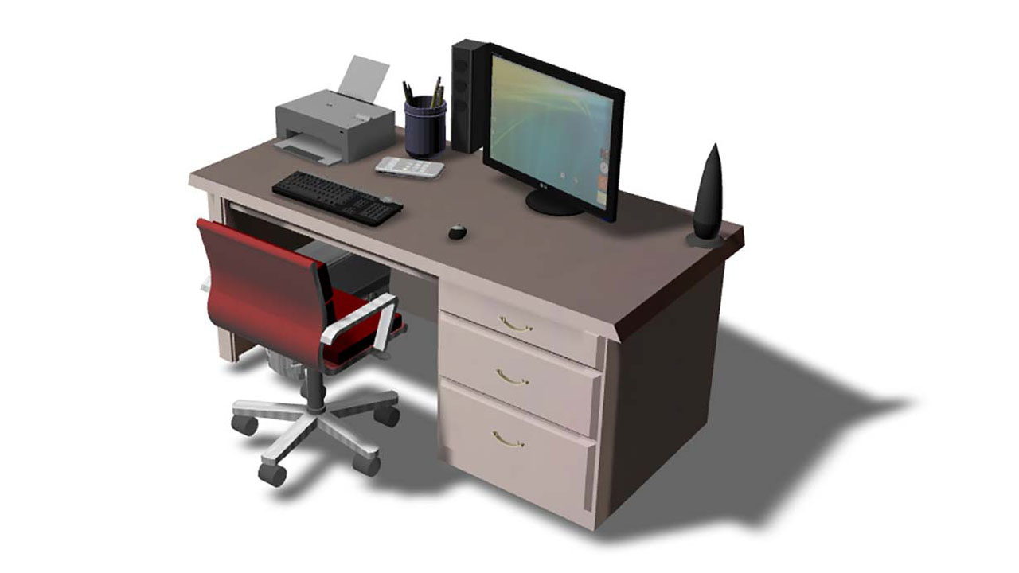
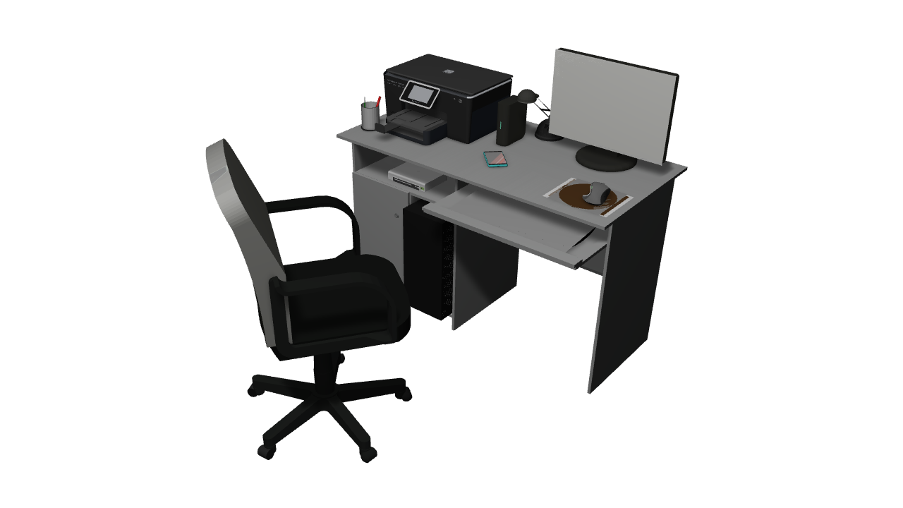
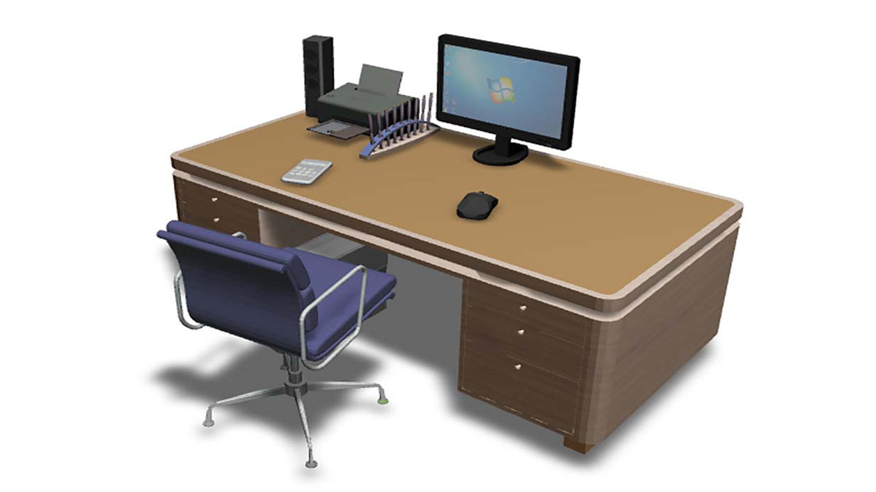
Evaluation: robustness to language variations
There is a desk and a chair. On the desk, there is a monitor, a printer and a speaker. On the desk, there is a holder, a cellphone and a mousepad with mouse on top. Put a computer under the desk.
There is a well organized work desk and a chair in front of it. There is printer and a holder on the desk. There is a cellphone on the desk.
S1
There is a desk with a monitor, a lamp, a printer, a cellphone and a holder. There is a mousepad on the desk. There is a mouse on the mousepad. There is a chair in front of the desk.
GT
GT description
Reference scene
(10 user descriptions)
S2
Notes:
As natural language is flexible, we further evaluate the robustness of our system to the language variations.
(CLICK) Given a reference image, we collect different descriptions from 10 users (CLICK).
and randomly select two descriptions (CLICK) to generate two scenes using our system, S1 and S2.
Next, we treat the reference scene (CLICK) as Ground Truth and select a description
(CLICK) from the rest 8 of the 10 descriptions as the ground truth description

Slide 44
Evaluation: robustness to language variations
Evaluation criteria
How closely S1, S2, or GT matches the GT description
Score explanation:
3 - Overall matches the description
4 - Matches the description closely
5 - Perfect Match
Notes:
Then we ask users to vote (CLICK) S1, S2 and GT based on how closely they match the ground truth description.
(CLICK) The average scores show our scenes generally match the ground truth description which means our method is robust to language variations.

Slide 45
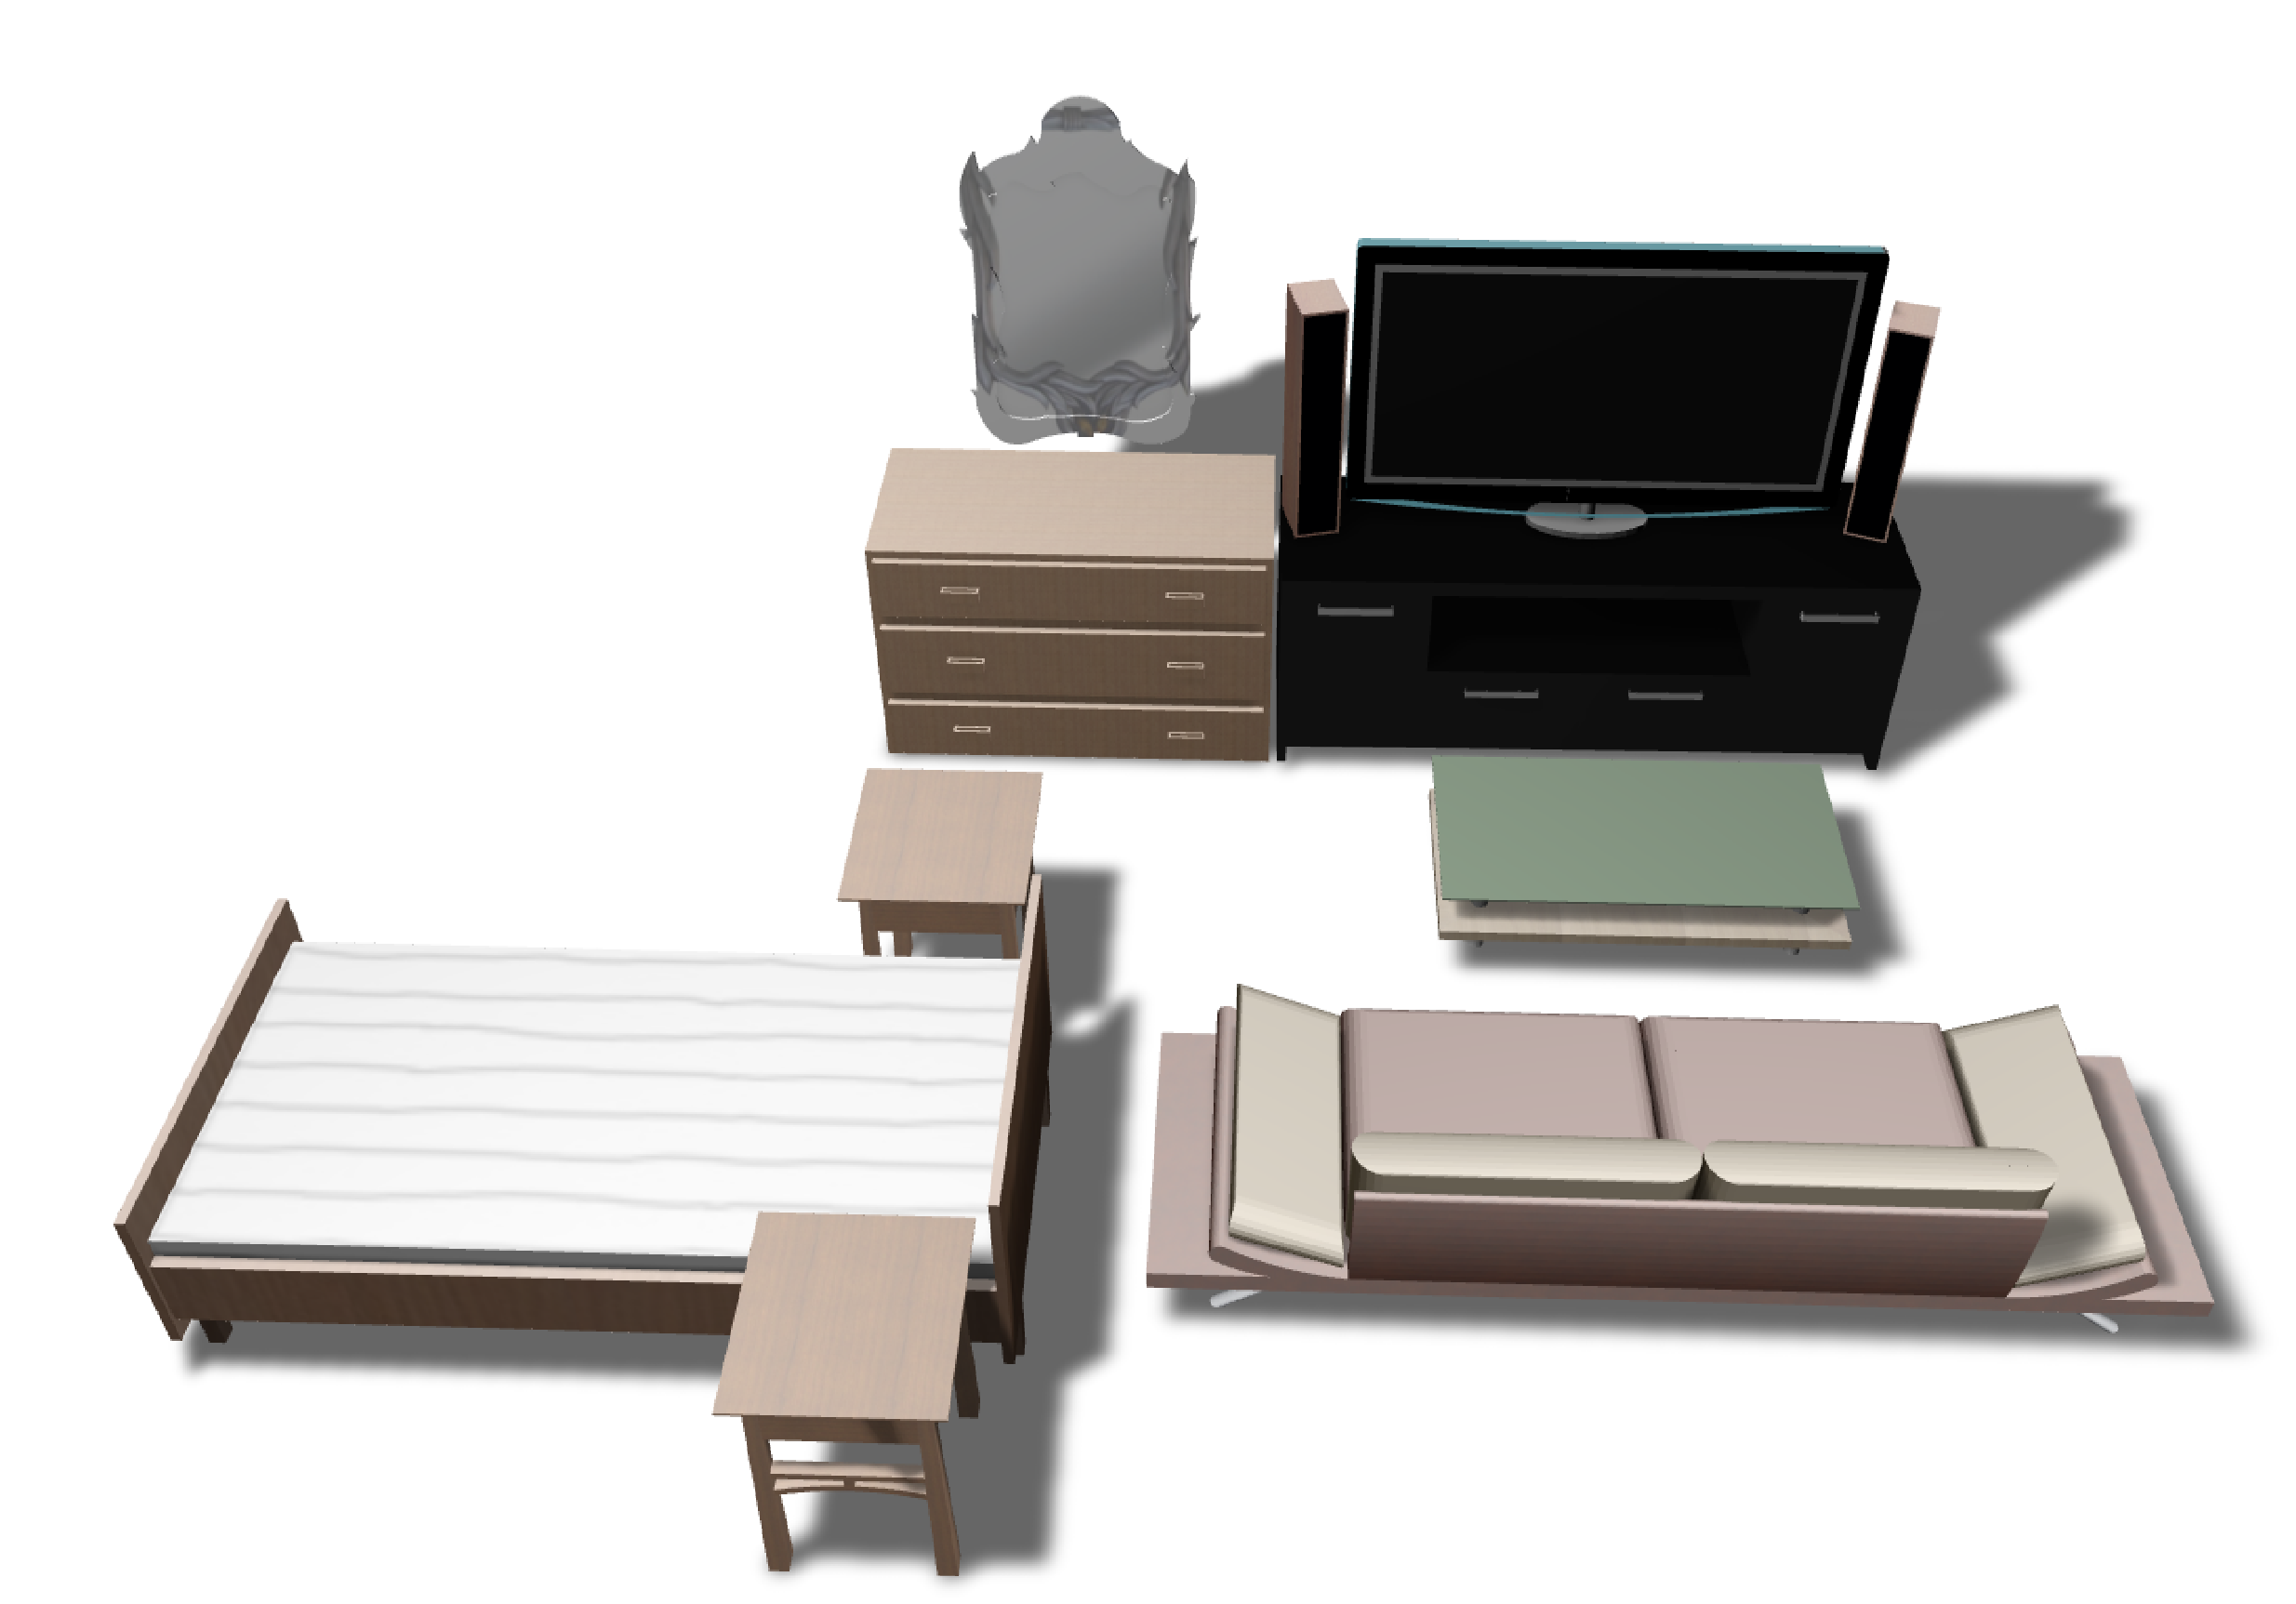

Limitation
No guarantee of global plausibility
Sequentially progressive synthesis based on individual sentences
In front of the dresser, there is a bed with two nightstands on each side.
Global plausibility optimization
Notes:
One main limitation for our current method is
(CLICK) it has no guarantee of global plausibility.
(CLICK) We only perform sequentially progressive synthesis based on the individual sentences
For example, given a scene on the right (CLICK) and a new sentence, we may produce a scene like this(CLICK), which seems implausible.
This is because the placement of the bed is mainly based on its specified relation “in front of the dresser”
To solve this problem, (CLICK) a global plausibility optimization after each progressive synthesis step may be applied.

Slide 46
Future work
Object geometry, symmetry, style and functionality
Evaluation
Objective plausibility measure
Notes:
For future work,
one direction is to (CLICK) explore the object geometry, scene symmetry, style, and functionality for the text2scene generation
(CLICK) Next, it is worth to develop better scene evaluation methods based objective scene plausibility measures instead of relying the evaluation purely on human judgements. (CLICK)

Slide 47
Future work
Object geometry, symmetry, style and functionality
Evaluation
Objective plausibility measure
Generality of relational model
From “messy table” to “messy room”
Truly creative modeling by Text2Scene
Generative models from deep learning
Notes:
Another future work could be improving the generality of our relational model. Currently, we do not learn the intrinsic meaning of a relation. Learning from a “messy table” and then applying the model to generate a “messy room” will be an interesting problem.
(CLICK) At last, achieving truly creative modeling by text2Scene is promising. Deep learning methods can be explored to train generative models from large-scale scene datasets and produce truly novel scenes.

Slide 48
Summary
Language-driven scene synthesis
Compact natural language
Complex results
Semantic scene graph for text-to-scene mapping
Relational model for semantic pairwise and group relations
Sub-scene retrieval and accommodation for progressive synthesis
Notes:
In summary,
(CLICK) we develop a language-driven scene synthesis framework which can use compact natural language to efficiently generate complex results.
(CLICK) The semantic scene graph is used as a uniform scene representation for text-to-scene mapping.
(CLICK) We learn the relational models which encode semantic pairwise and group relations from annotated scene databases.
To achieve progressive synthesis, we propose (CLICK) the sub-scene retrieval and accommodation framework to generate and edit scenes.

Slide 49
Acknowledgement
Anonymous reviewers
Research grants
NSERC, NSF, Stanford AI Lab-Toyota Center Singapore MOE, HKUST, Adobe and Amazon AWS
Artist and user study participants
Notes:
At last, thanks the reviewers, our grants, artists and the user study participants for their help with our work.

Slide 50
Thank you!
Scene databases
Current scene
There is a monitor on the desk and a lamp to the left of the monitor.
New scene
Retrieval
Accommodation

